Slide 1


DATA LITERATE
JOINT-VENTURE PRFILE

Slide 2



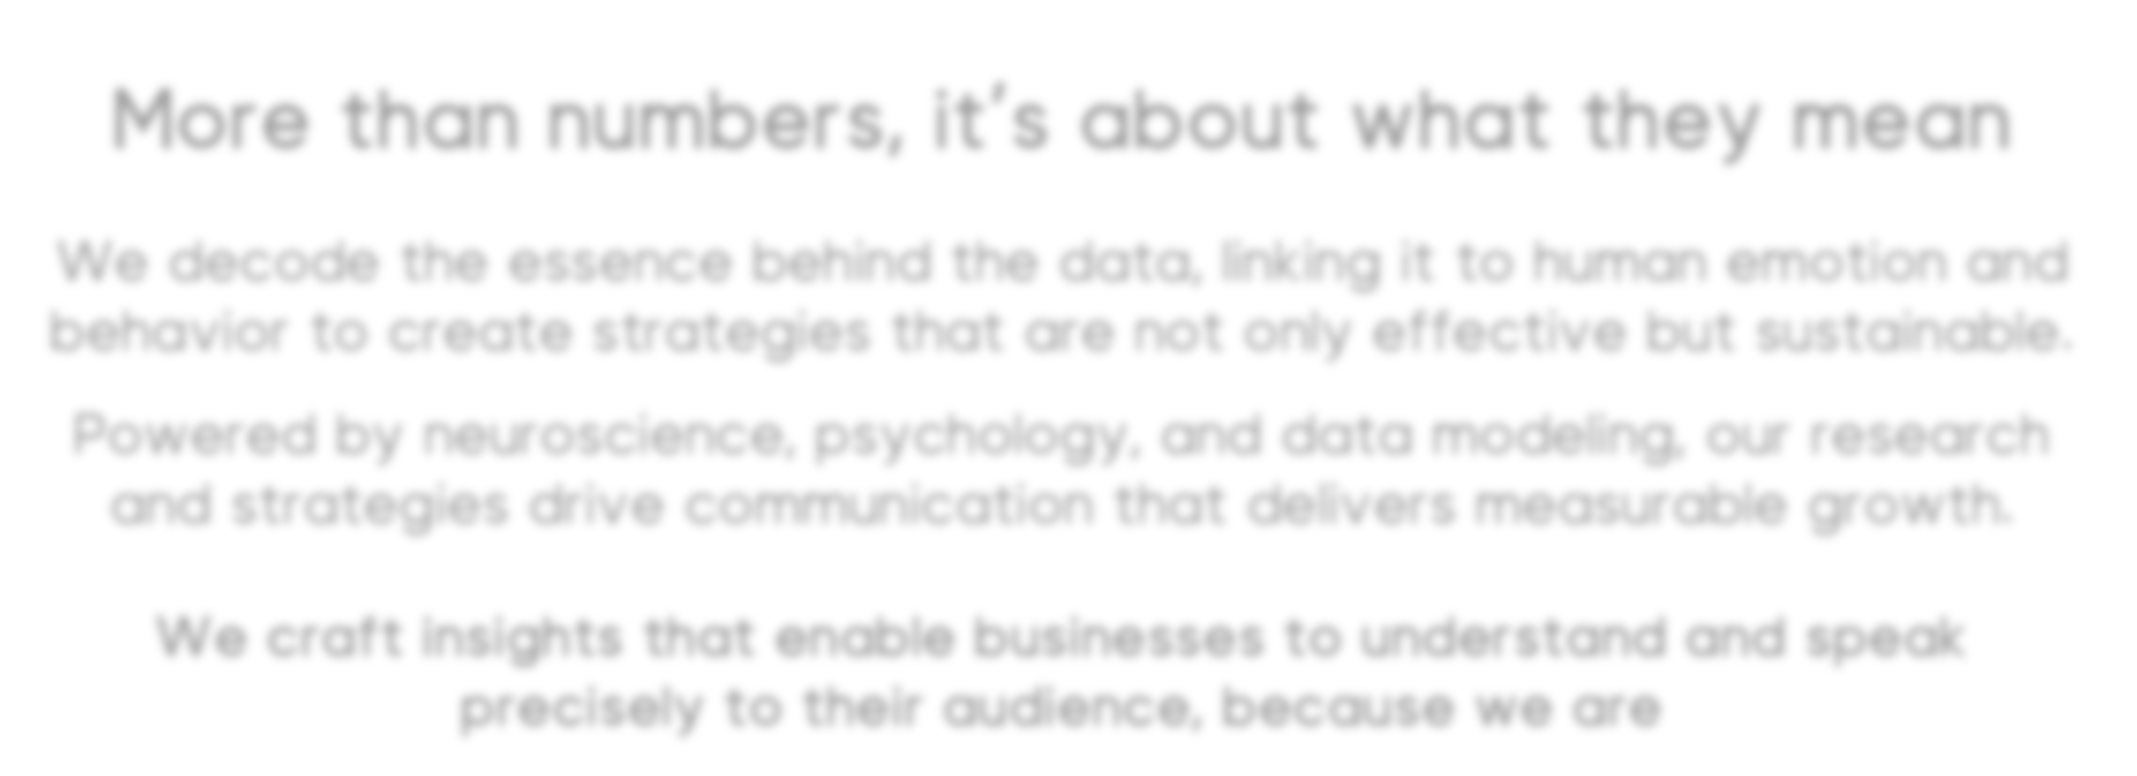




More than numbers, it’s about what they mean
We decode the essence behind the data, linking it to human emotion and behavior to create strategies that are not only effective but sustainable.
Powered by neuroscience, psychology, and data modeling, our research and strategies drive communication that delivers measurable growth.
We craft insights that enable businesses to understand and speak precisely to their audience, because we are
DATA LITERATE

Slide 3

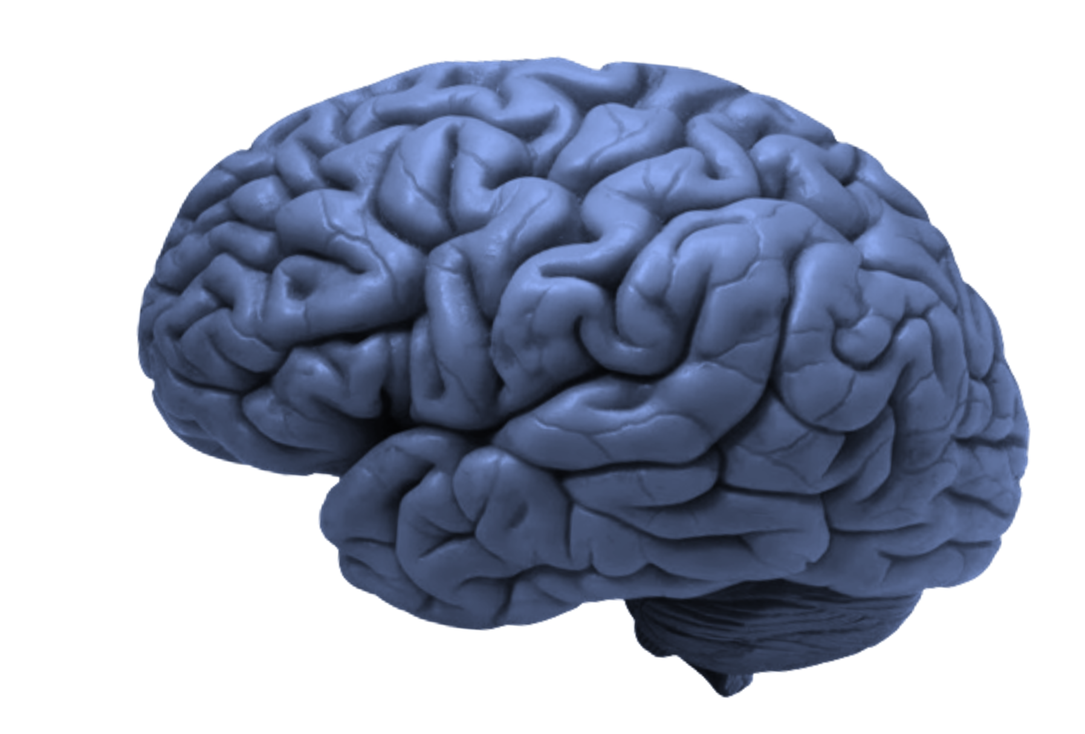

Who We Are
Lime Lab is a company based in Lebanon, with active presence in Jordan through joint venture and expert collaboration.
At the core is a commitment to transforming data into clarity. With
+95% data accuracy, insights are delivered with supreme precision; empowering businesses to make confident decisions, reduce risk, and avoid strategic errors.
Human emotion and behavior are uncovered using advanced neuromarketing technologies, while the proprietary branding psychology methodology, featured in our book ‘Brands on the Therapy Couch’; drive deep audience connection.
Through the integration of AI-based data modeling, strategies are built on intelligence, not assumptions, ensuring that every move is backed by science.
This is where real growth begins.
This is how lasting audience relationships are formed. This is the clarity every business leader strives for.
This is what Lime Lab delivers.

Slide 4







2
1
3
Branding
Neuro-
Psychology
Business
Our pillars
marketing
Genetics
4
5
Data
Think-Tank
Modeling
Circle

Slide 5

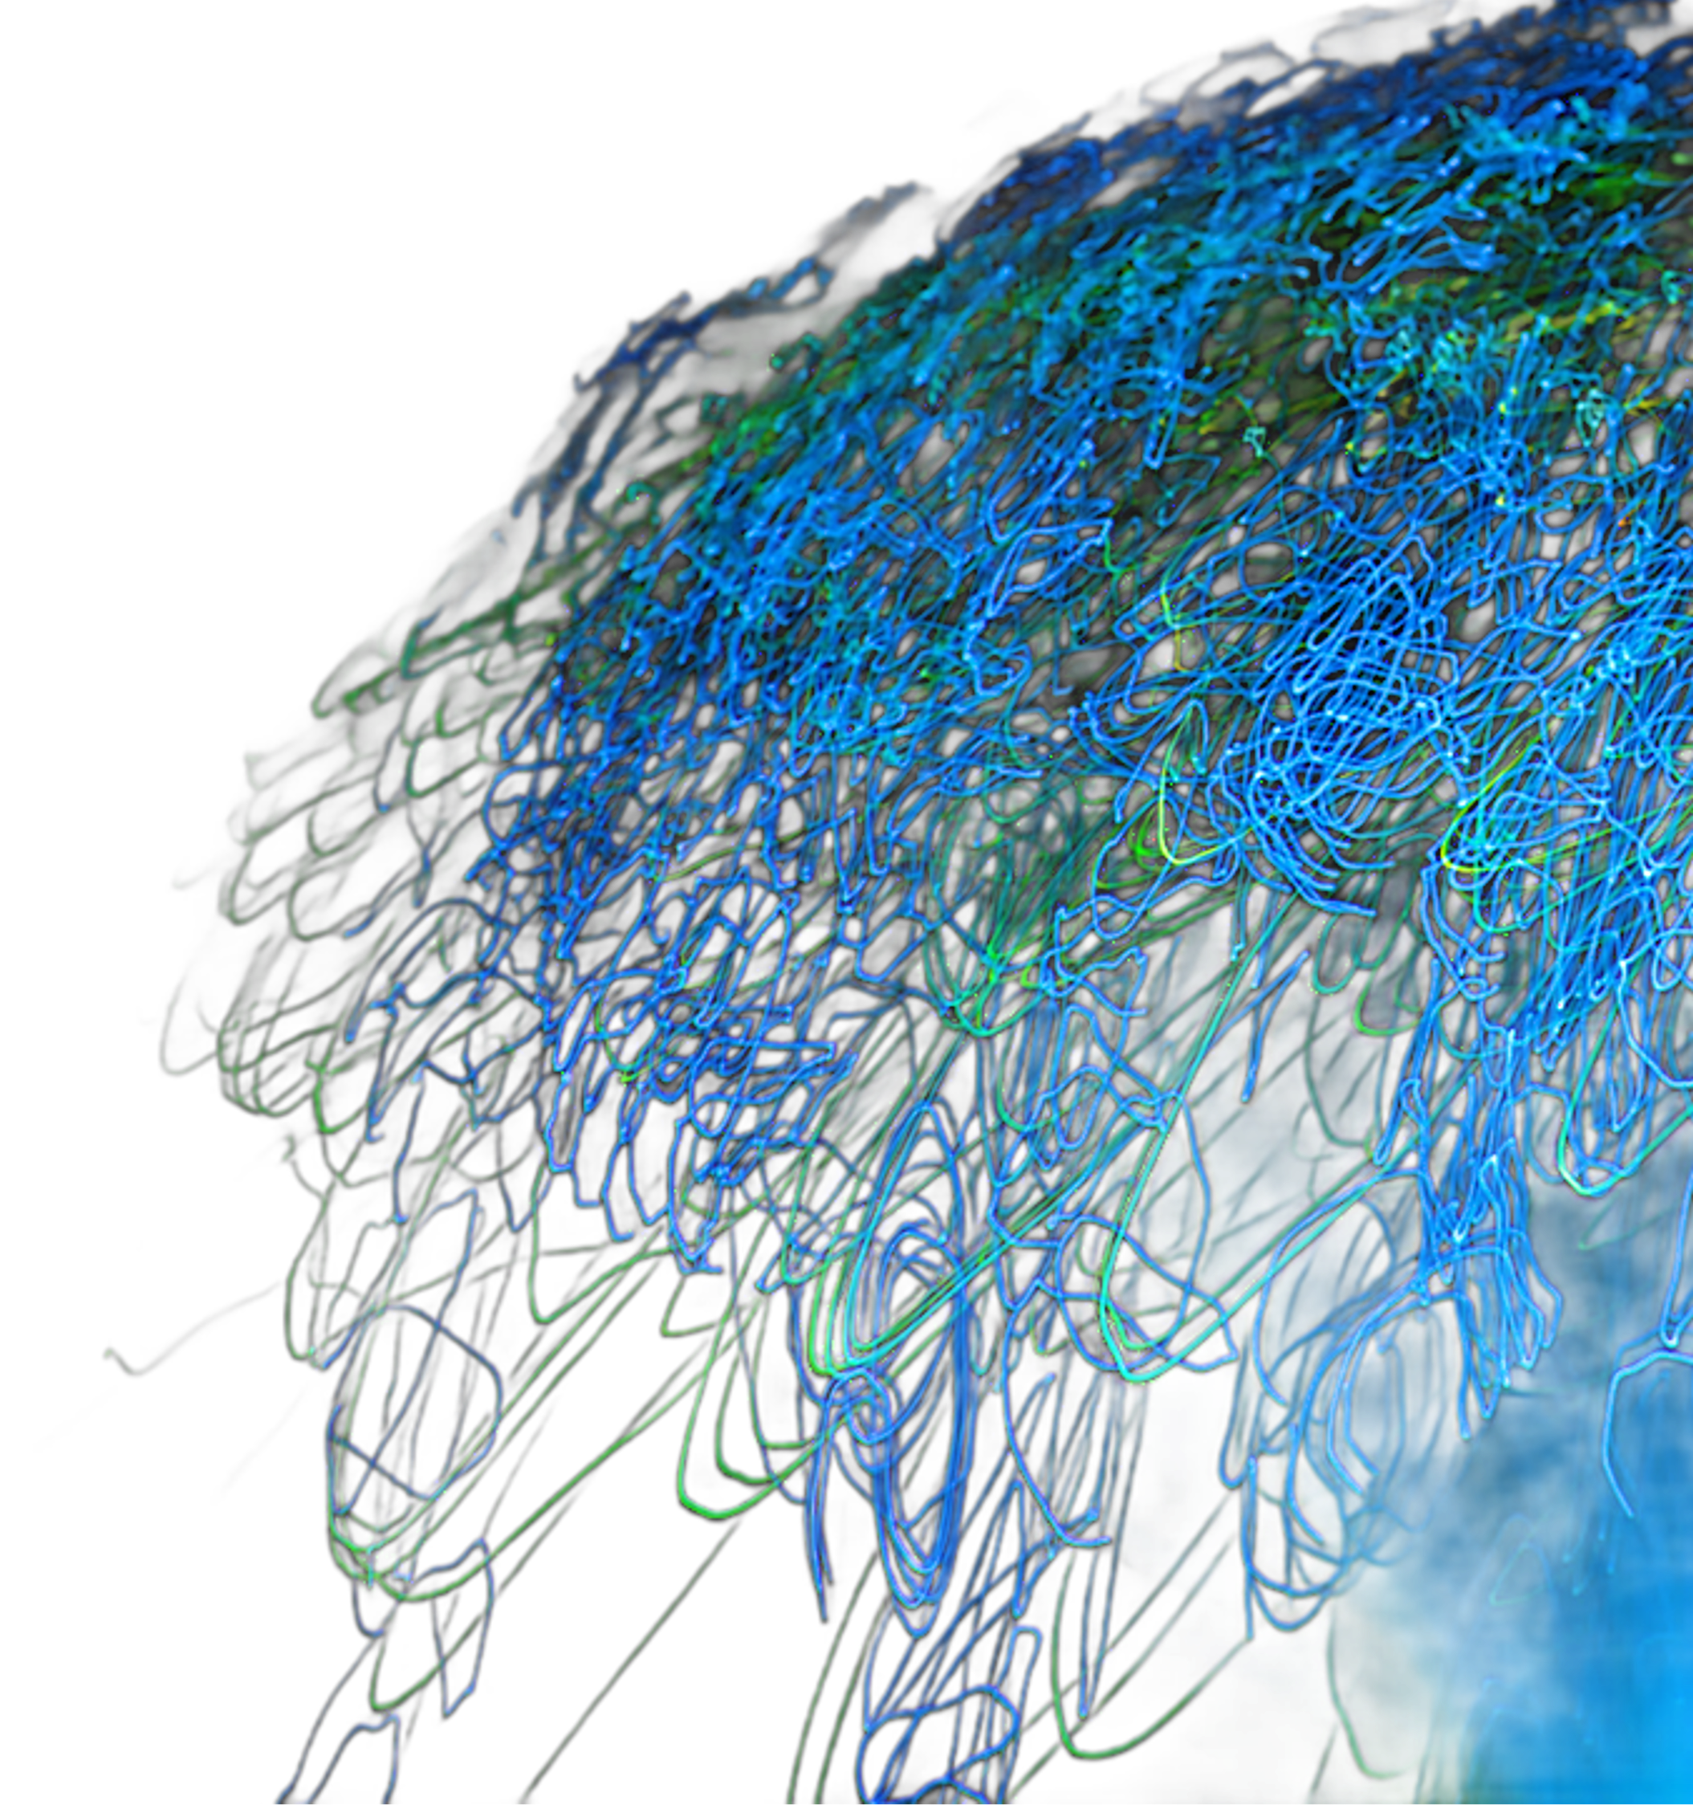


Neuro- marketing
1
The science of understanding how consumers truly feel, think, and decide, beyond what they say.
Neuromarketing uses neuroscience and biometric tools to explore the subconscious drivers behind choices. It reveals the emotions and reactions that traditional research methods often miss.
By measuring brain activity, attention, and emotional response, neuromarketing provides insights into what truly influences decision-making.
It is not about what consumers claim to prefer.
It is about uncovering what they actually respond to.
Neuromarketing brings science into strategy, helping brands connect, persuade, and grow with precision.

Slide 6

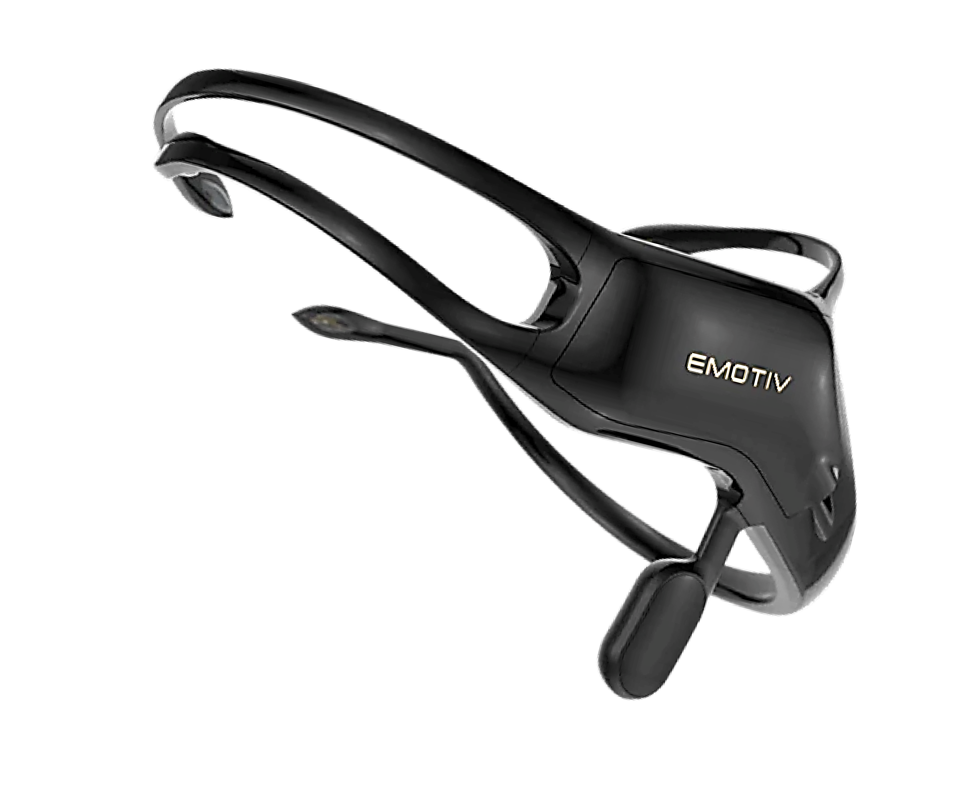

EEG
Electroencephalogram
One of the most powerful tools in neuromarketing. It captures real-time brainwave activity to measure attention, engagement, emotional intensity, and cognitive load as consumers interact with ads, packaging, products, physical and digital experiences…etc. without needing them to say a word.
EEG helps discover what grabs attention, triggers emotion, or causes mental effort, giving brands a window into the subconscious mind.

Slide 7

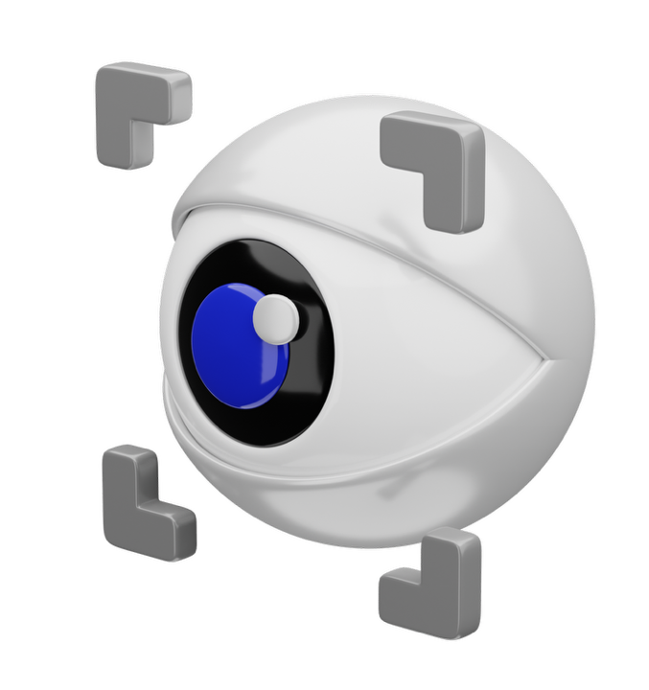

eye-tracking
AI-based eye-tracking is a neurotechnology that predicts where people will look first in any visual design within just 3 to 5 seconds.
Unlike traditional eye-tracking that requires physical devices and human testing, this solution uses deep learning models trained on over 5.5 million real eye movements to simulate human vision with up to 96% accuracy.
It shows exactly which parts of a post, ad, or visual draw attention and which get ignored.
That means you can test your content before publishing, ensuring your brand, message, and call-to- action are seen clearly, instantly, and in the right order.

Slide 8
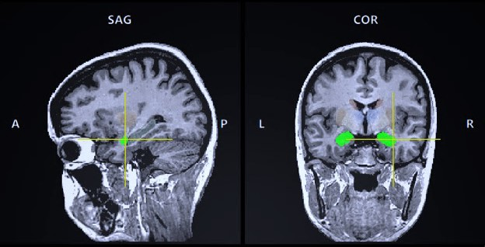

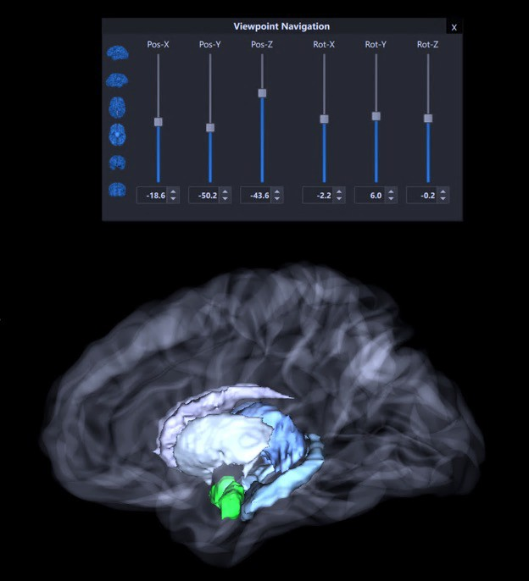
Brain mapping
Brain mapping is like drawing a roadmap of your audience’s emotions. It’s not just about what they say; it’s about what their brains tell us.
We measure engagement, excitement, stress, and more by tracking brain activity. It’s like reading their emotional dashboard.
Knowing what gets the brain fired up means we can design marketing that hits those emotional buttons on purpose.
We go one step further, pinpointing exactly which parts of the brain are involved. Think of it like targeting the heart of the decision-making process.

Slide 9


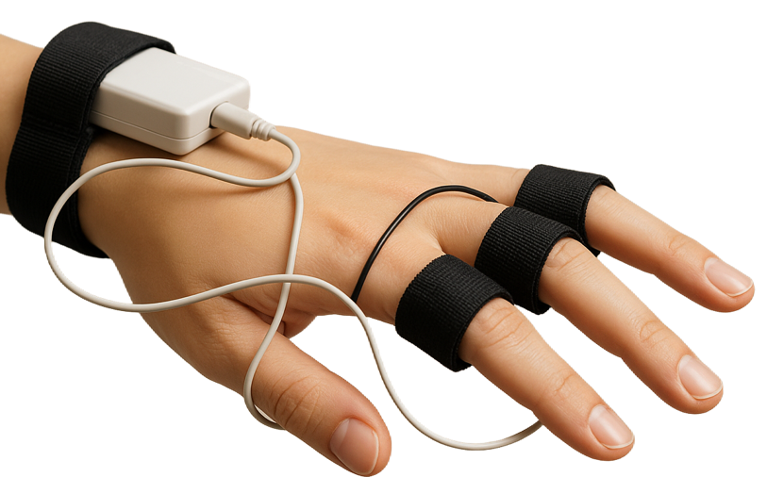

Galvanic skin response
GSR measures subtle changes in skin conductance triggered by emotional arousal. It helps detect how strongly a person reacts to content, even if they can't express it. This tool reveals real-time emotional intensity, allowing brands to understand which moments spark excitement, stress, or engagement.

Slide 10
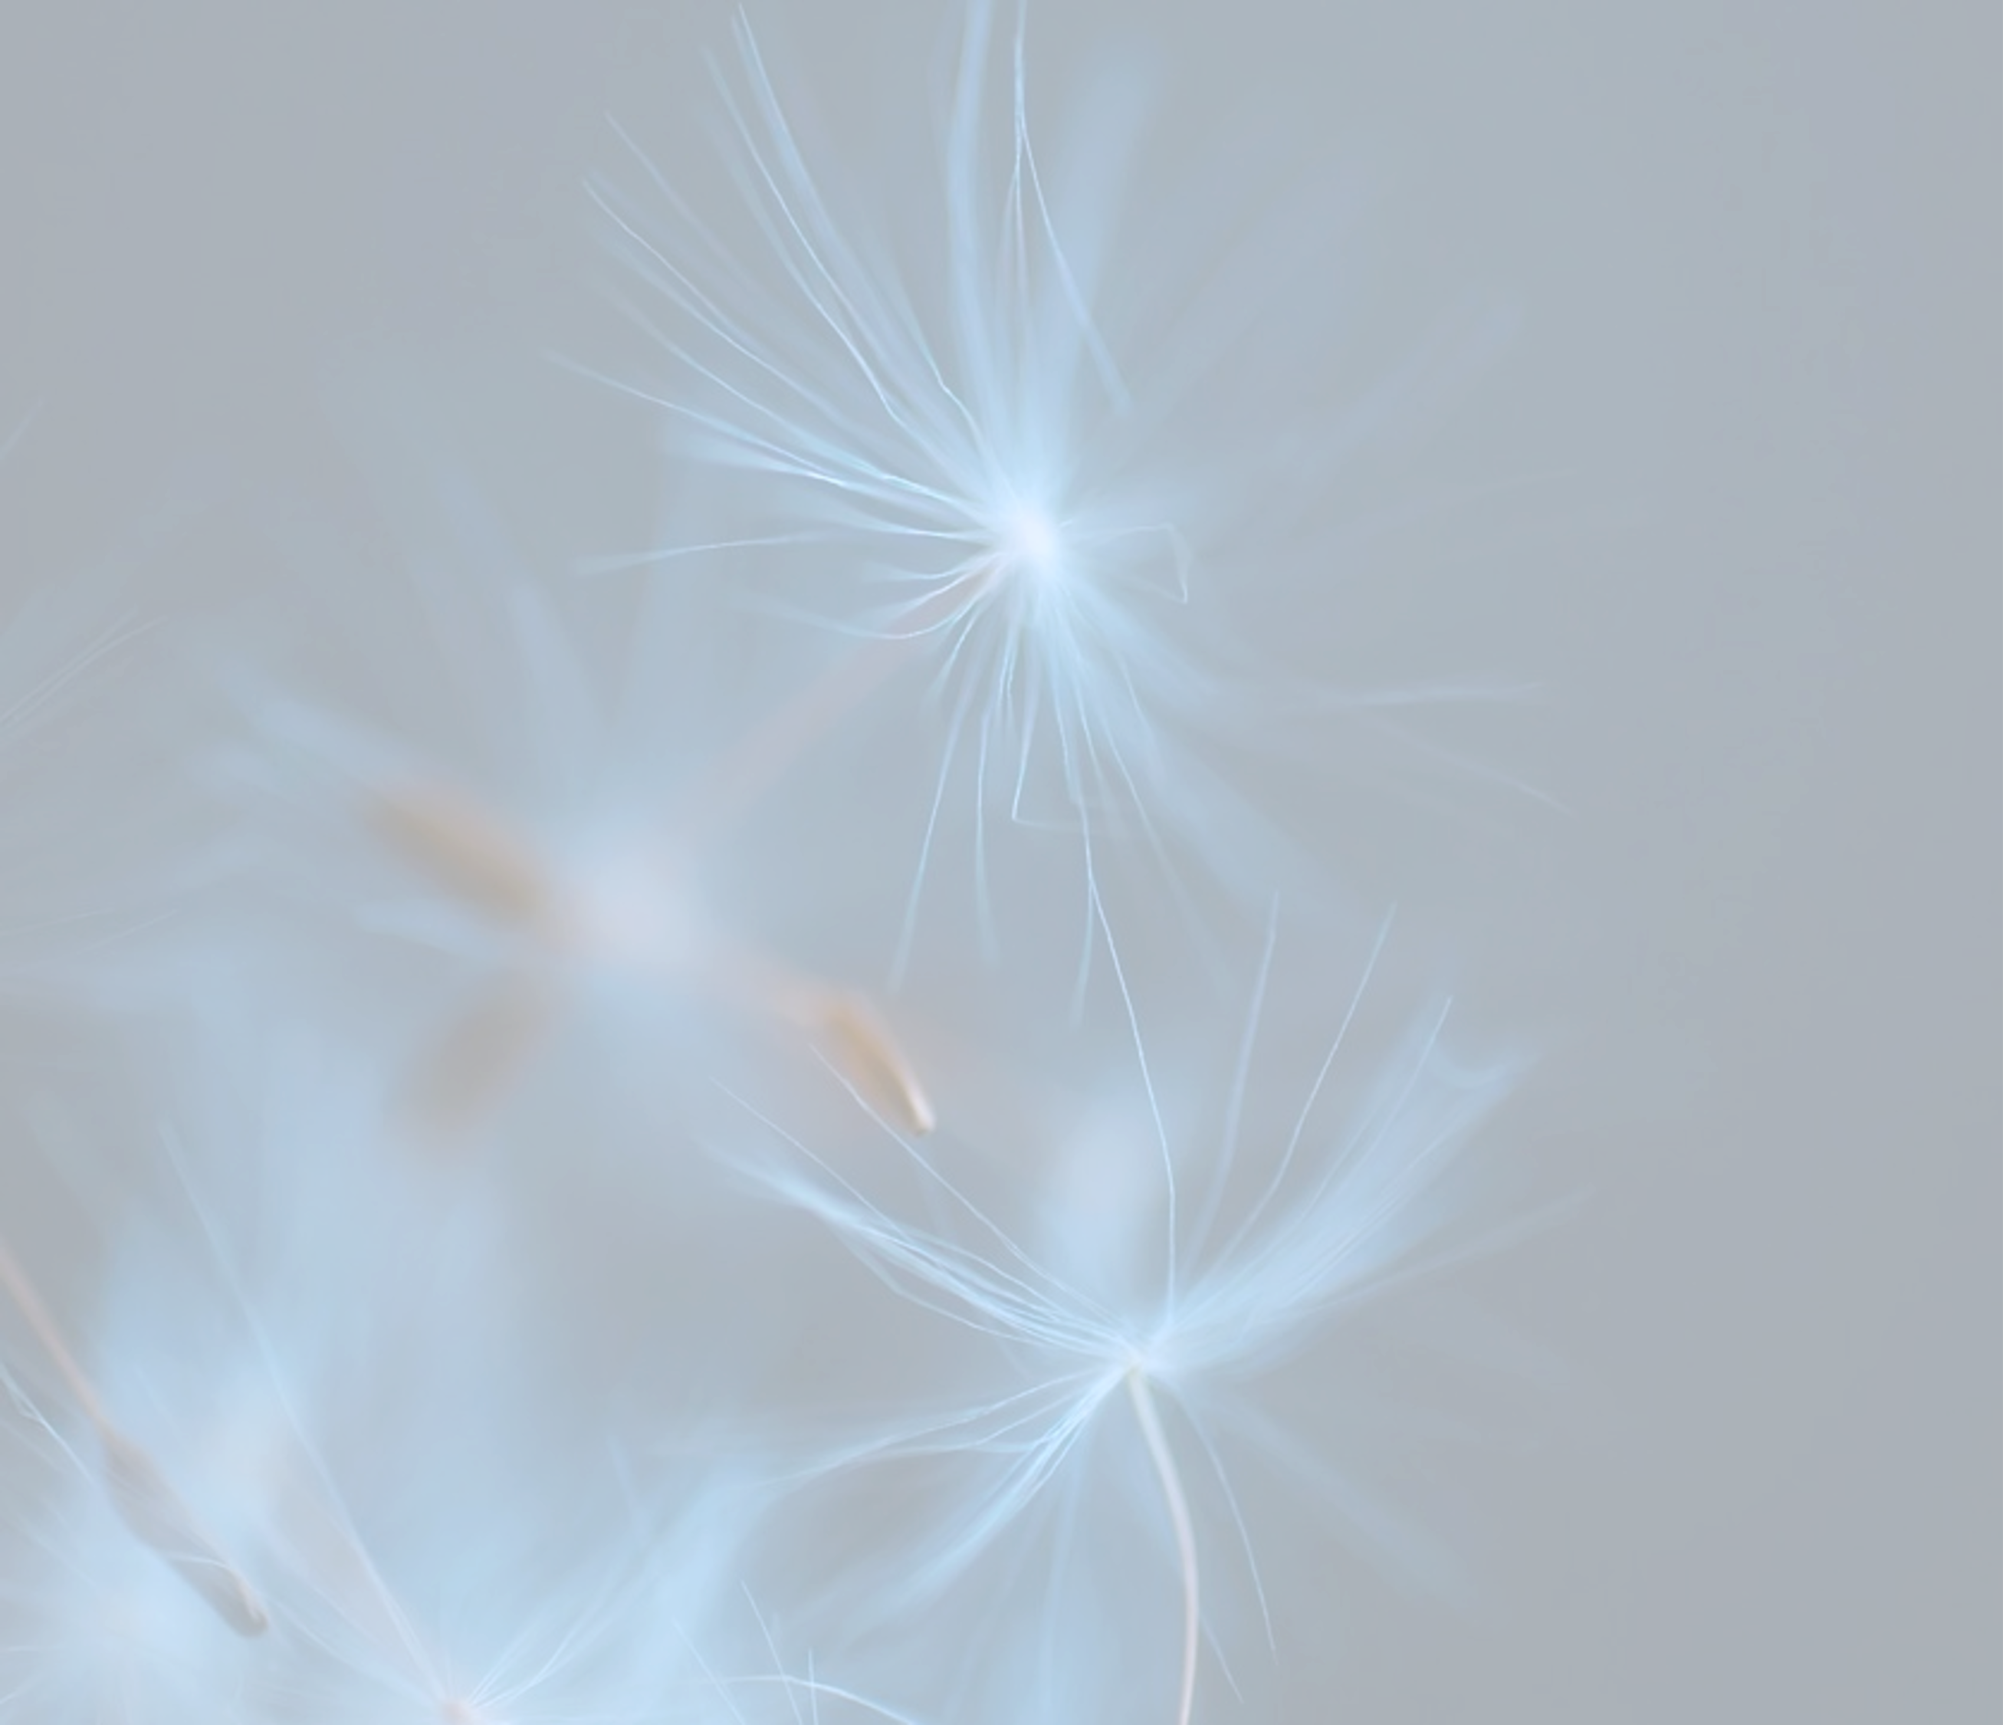



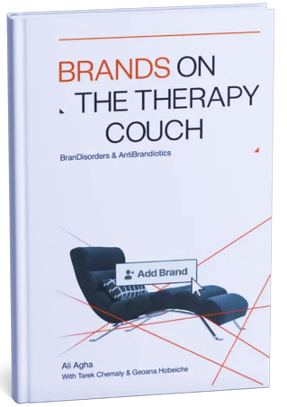

Branding
2
Psychology
This pillar is rooted in the methodology of Brands on the Therapy Couch, our book that approaches branding through the lens of psychology, not just marketing.
At its core is the BranDisorders Wheel, a diagnostic tool that identifies 20 distinct disorders. These help uncover what is holding a brand back, from identity confusion to emotional disconnection or audience misalignment.
To address these challenges, the AntiBrandiotics methodology was developed. It is a structured framework designed to prevent, treat, or reverse brand disorders through psychologically grounded strategies.
At Lime Lab, this approach ensures that every branding and rebranding process begins with a clear psychological diagnosis and leads to a strategy that is emotionally intelligent, behaviorally aligned, and scientifically sound.

Slide 11


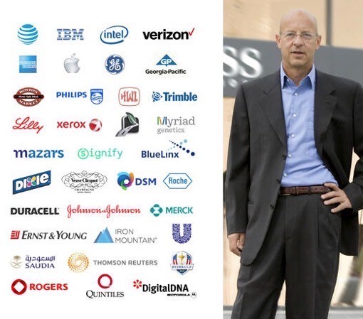


“You had me at page 1 when you say “…treat brands as if they were humans, each with its own unique struggles … placing brands on the metaphorical therapy couch to explore their disorders”. Brilliant perspectives that are extremely helpful in diagnosing the issues, and then a clear examination of targeted problem-solving action and tools. I will definitely use these notions in my corporate branding work.”
Quirino Malandrino
Brand counsel at BrandLink, New York

Slide 12





“An intriguing, thoughtful and entirely original approach to branding, this book requires your full attention. It is not for the faint-hearted, but whether you are consumer or a brand owner, it is a deep voyage into the psyche of brands, the ailments that weaken them – and the solutions that will allow them to thrive.”
Mark Tungate
Editorial Director, The Epica Awards

Slide 13


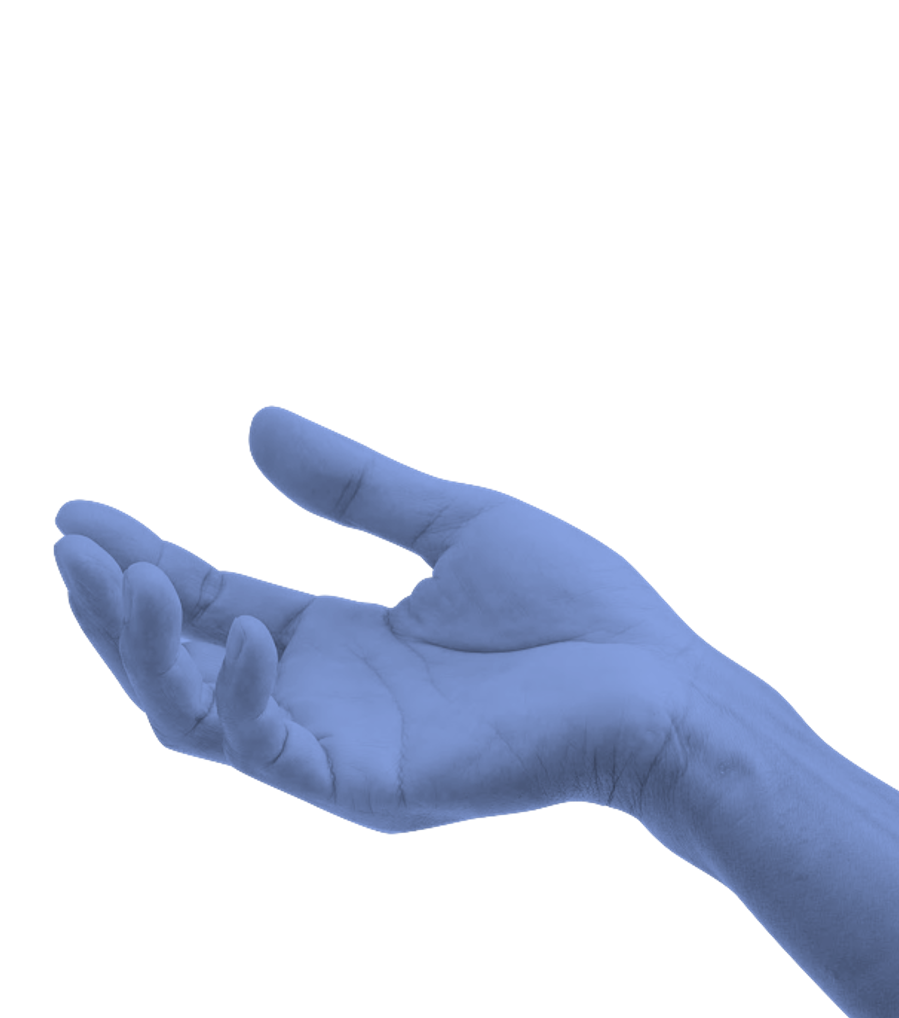
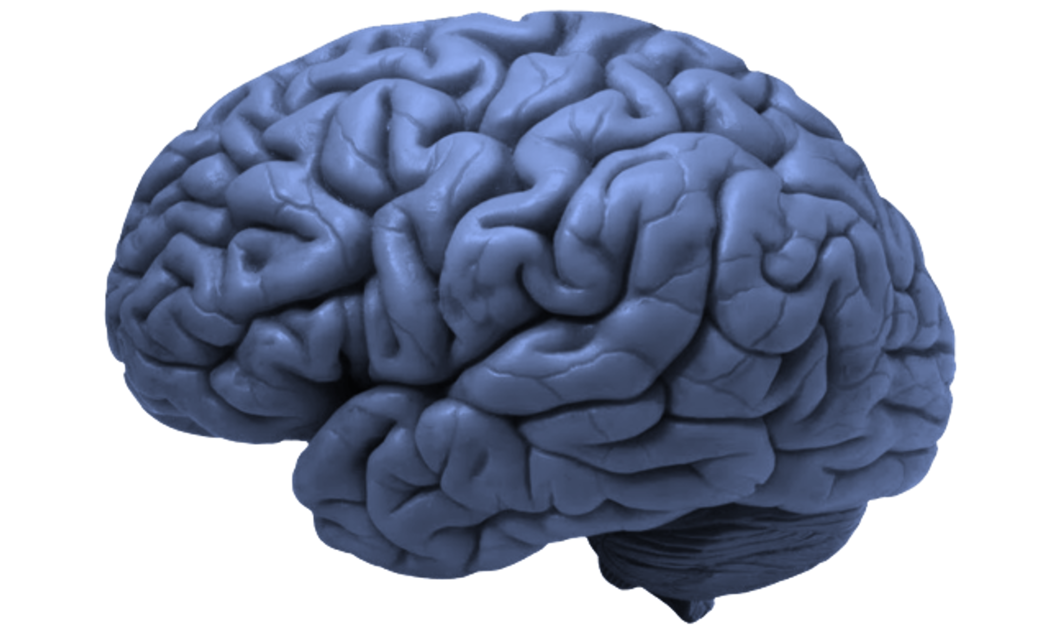


Business genetics
3
Every business has a unique genetic code, the internal structure that defines how it grows, adapts, and performs.
This pillar focuses on decoding that structure using insights drawn from neuroscience, psychology, and data modeling.
Business Genetics builds strategies, models, market research, and governance systems that are accurate, scalable, and rooted in behavioral intelligence. It transforms business planning from assumption to precision.
Because in business, structure is not support. It is strategy.

Slide 14
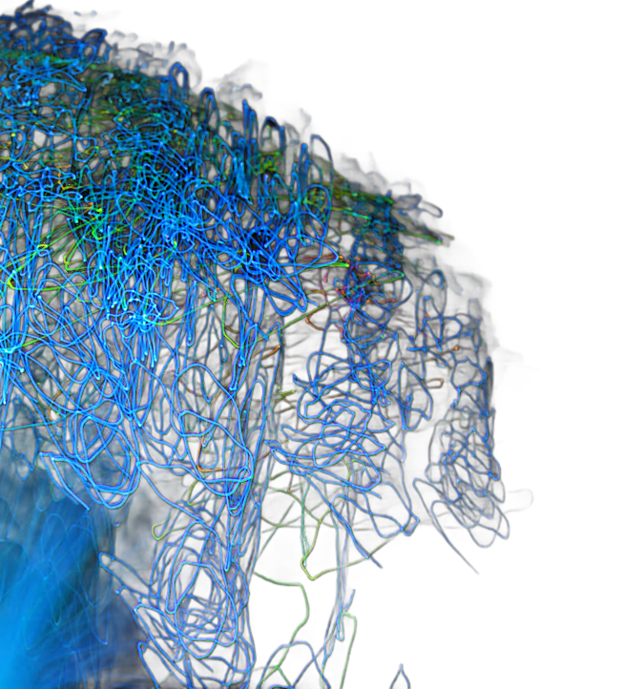



Ai-data modeling
4
This is where raw data transforms into direction.
At Lime Lab, data modeling is powered by advanced neurotechnology (EEG, eye-tracking, brain mapping, and GSR) and enhanced through AI and machine learning techniques.
By applying training-validation methods and algorithmic models, emotional and behavioral responses are translated into precise, measurable formulas. These models are not one-size-fits-all, they are customized to reflect each client’s industry, customer experience, and business challenge.
The result is tailored insights with +95% accuracy, reducing guesswork and providing data that directly guides strategy, communication, and operations, all built on science, not assumptions.

Slide 15


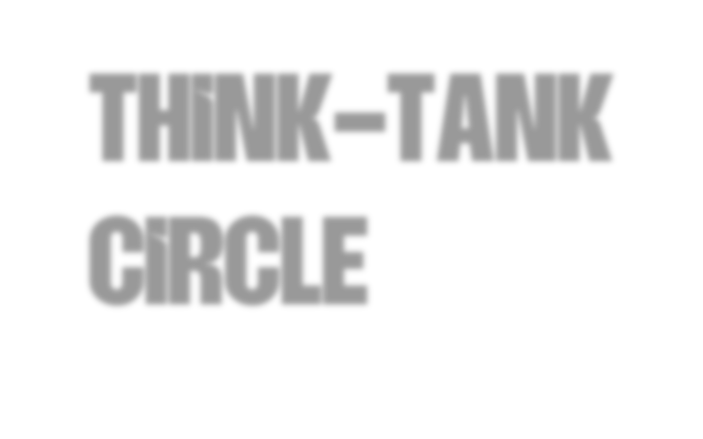
Think-Tank Circle
5
The Think–Tank Circle is an alliance of leading experts, collaborators, and senior consultants across industries who bring strategic depth to every project.
This pillar connects Lime Lab with a broader intellectual network, offering advisory across business, finance, communication, behavioral science, branding, and policy.
The Think–Tank Circle plays a critical role in validating strategies, challenging assumptions, and unlocking high-level perspectives that ensure each solution is grounded, future-ready, and impactful.
It’s not just about what the data says. It’s about what the right minds can do with it.

Slide 16





Our services
Neuromarketing
Research Strategies
Visual identity testing
AI-generated videos testing
Blind taste testing (food/beverage)
Product testing
Packaging effectiveness testing
UI/UX testing
Advertising campaign testing
In-store communication testing
Sonic branding testing
Exploratory market research
Descriptive market research
Causal market research
Market needs analysis
Consumer behavior analysis
Brand perception research
Target audience mapping and analysis
Competitive landscape assessment
Trend and foresight research
Business strategy
Brand strategy
Rebranding strategy
Governance and policies
360 MarCom strategy
Go-to-market strategy
Growth strategy
Digital marketing strategies
Social media strategy

Slide 17



HOW CAN NEUROMARKETING
HELP YOUR BRAND?

Slide 18





UNDERSTANDING CONSUMER BEHAVIOR
WHAT’S HOLDING YOU BACK
You have insights, but you’re still unsure what drives your audience’s decisions.
HOW WE SOLVE IT
Neuromarketing unlocks the unconscious layer of decision-making. Using a combination of EEG (to track brain activity), GSR (to detect emotional arousal), and AI-based eye-tracking (to reveal what captures and holds attention), we uncover how your audience genuinely perceives your message, visuals, and experience.
The result? Actionable data that reveals motivations, preferences, and barriers with scientific clarity.

Slide 19

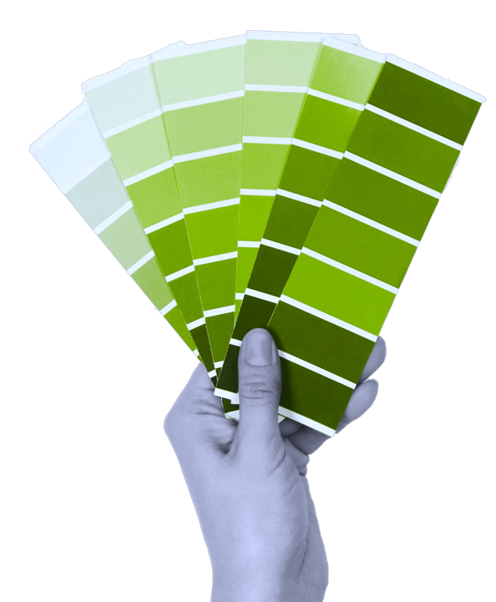


CREATING EMOTIONALLY RESONANT BRAND STRATEGIES
WHAT’S HOLDING YOU BACK
You’re not sure how to shape a brand that truly reflects what your audience needs and feels.
HOW WE SOLVE IT
We go deeper than surface insights to decode the emotional matrix of needs that drive your audience.
Through a unique combination of EEG, focus groups, and in- depth psychological interviews, we identify unspoken motivations, emotional drivers, and behavioral cues.
We then translate these findings into clear strategic assets:
Archetypes that embody your brand’s emotional role.
Tone of voice that speaks directly to audience sensibilities.
Color palettes and visual codes that evoke the right psychological response.
This ensures your brand isn’t just seen or heard, it’s felt.

Slide 20

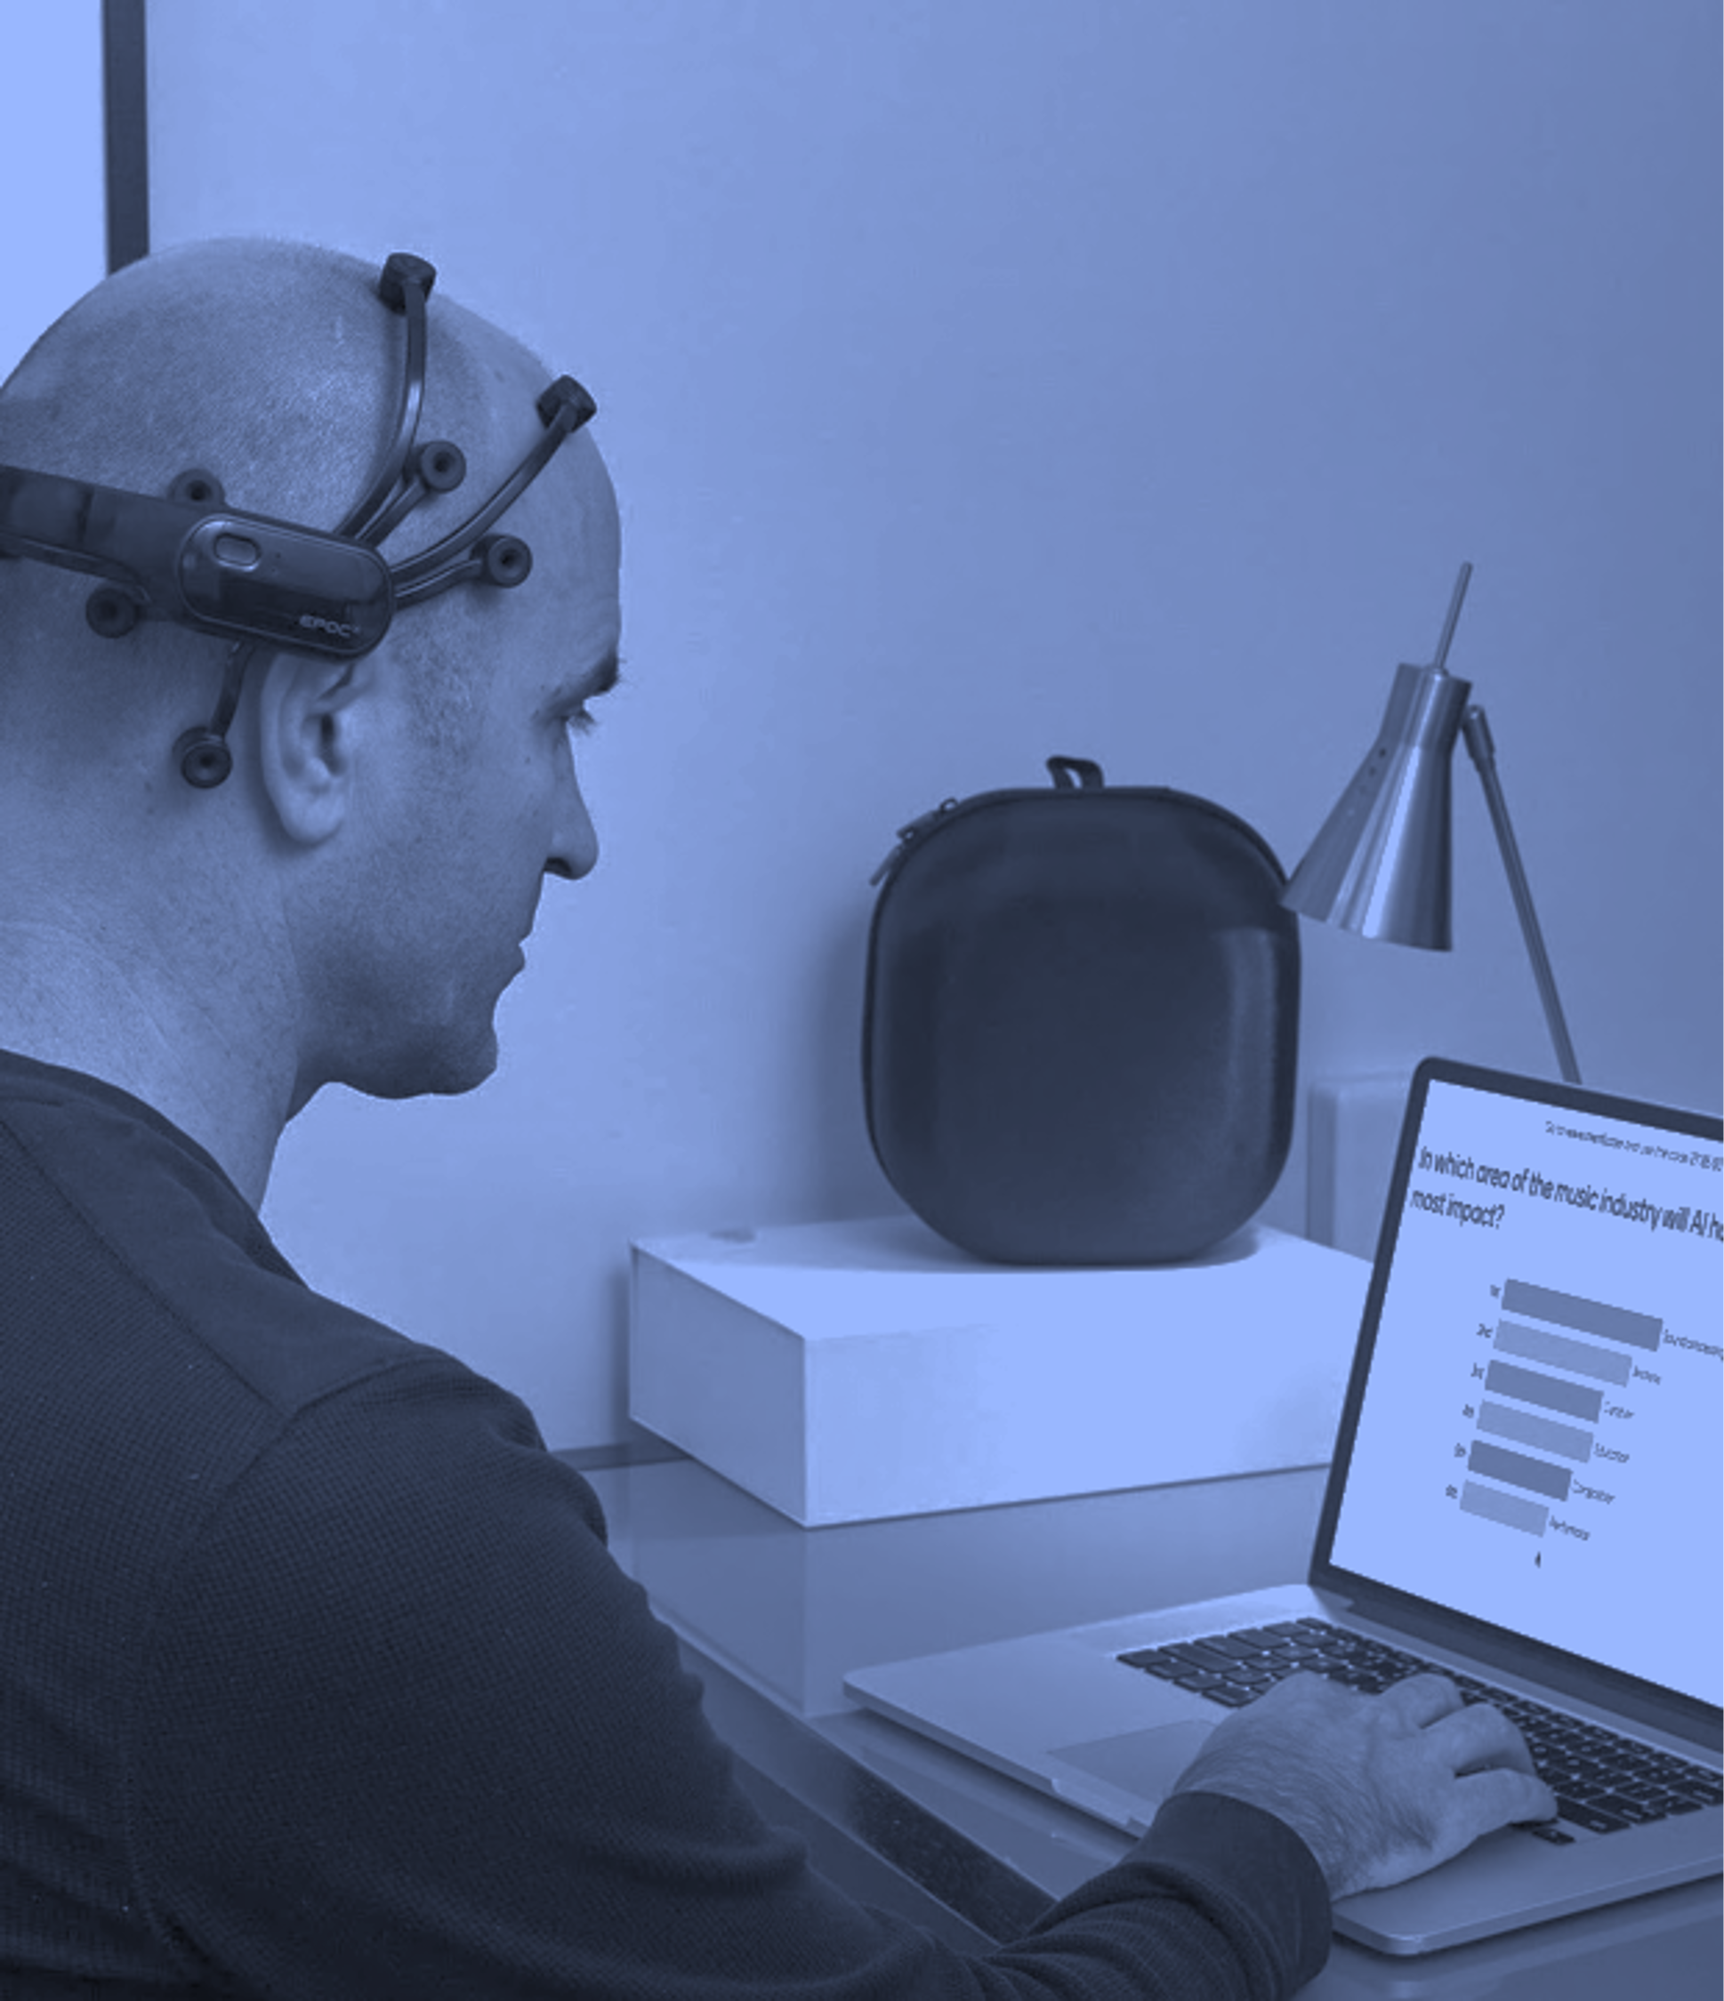


OPTIMIZING CAMPAIGN EFFECTIVENESS AND ROI
WHAT’S HOLDING YOU BACK
Your campaigns look great on paper, but outcomes are unpredictable.
HOW WE SOLVE IT
We make sure creative decisions are backed by science, not assumptions.
Using EEG, GSR, and AI-based eye-tracking, we
pre-test campaign materials; videos, visuals, digital ads, to assess clarity, engagement, and emotional resonance before launch.
You’ll know which version performs best, where attention is focused, and whether the emotional tone matches your objectives.
This eliminates guesswork, optimizes spend, and boosts conversion potential from the start.

Slide 21

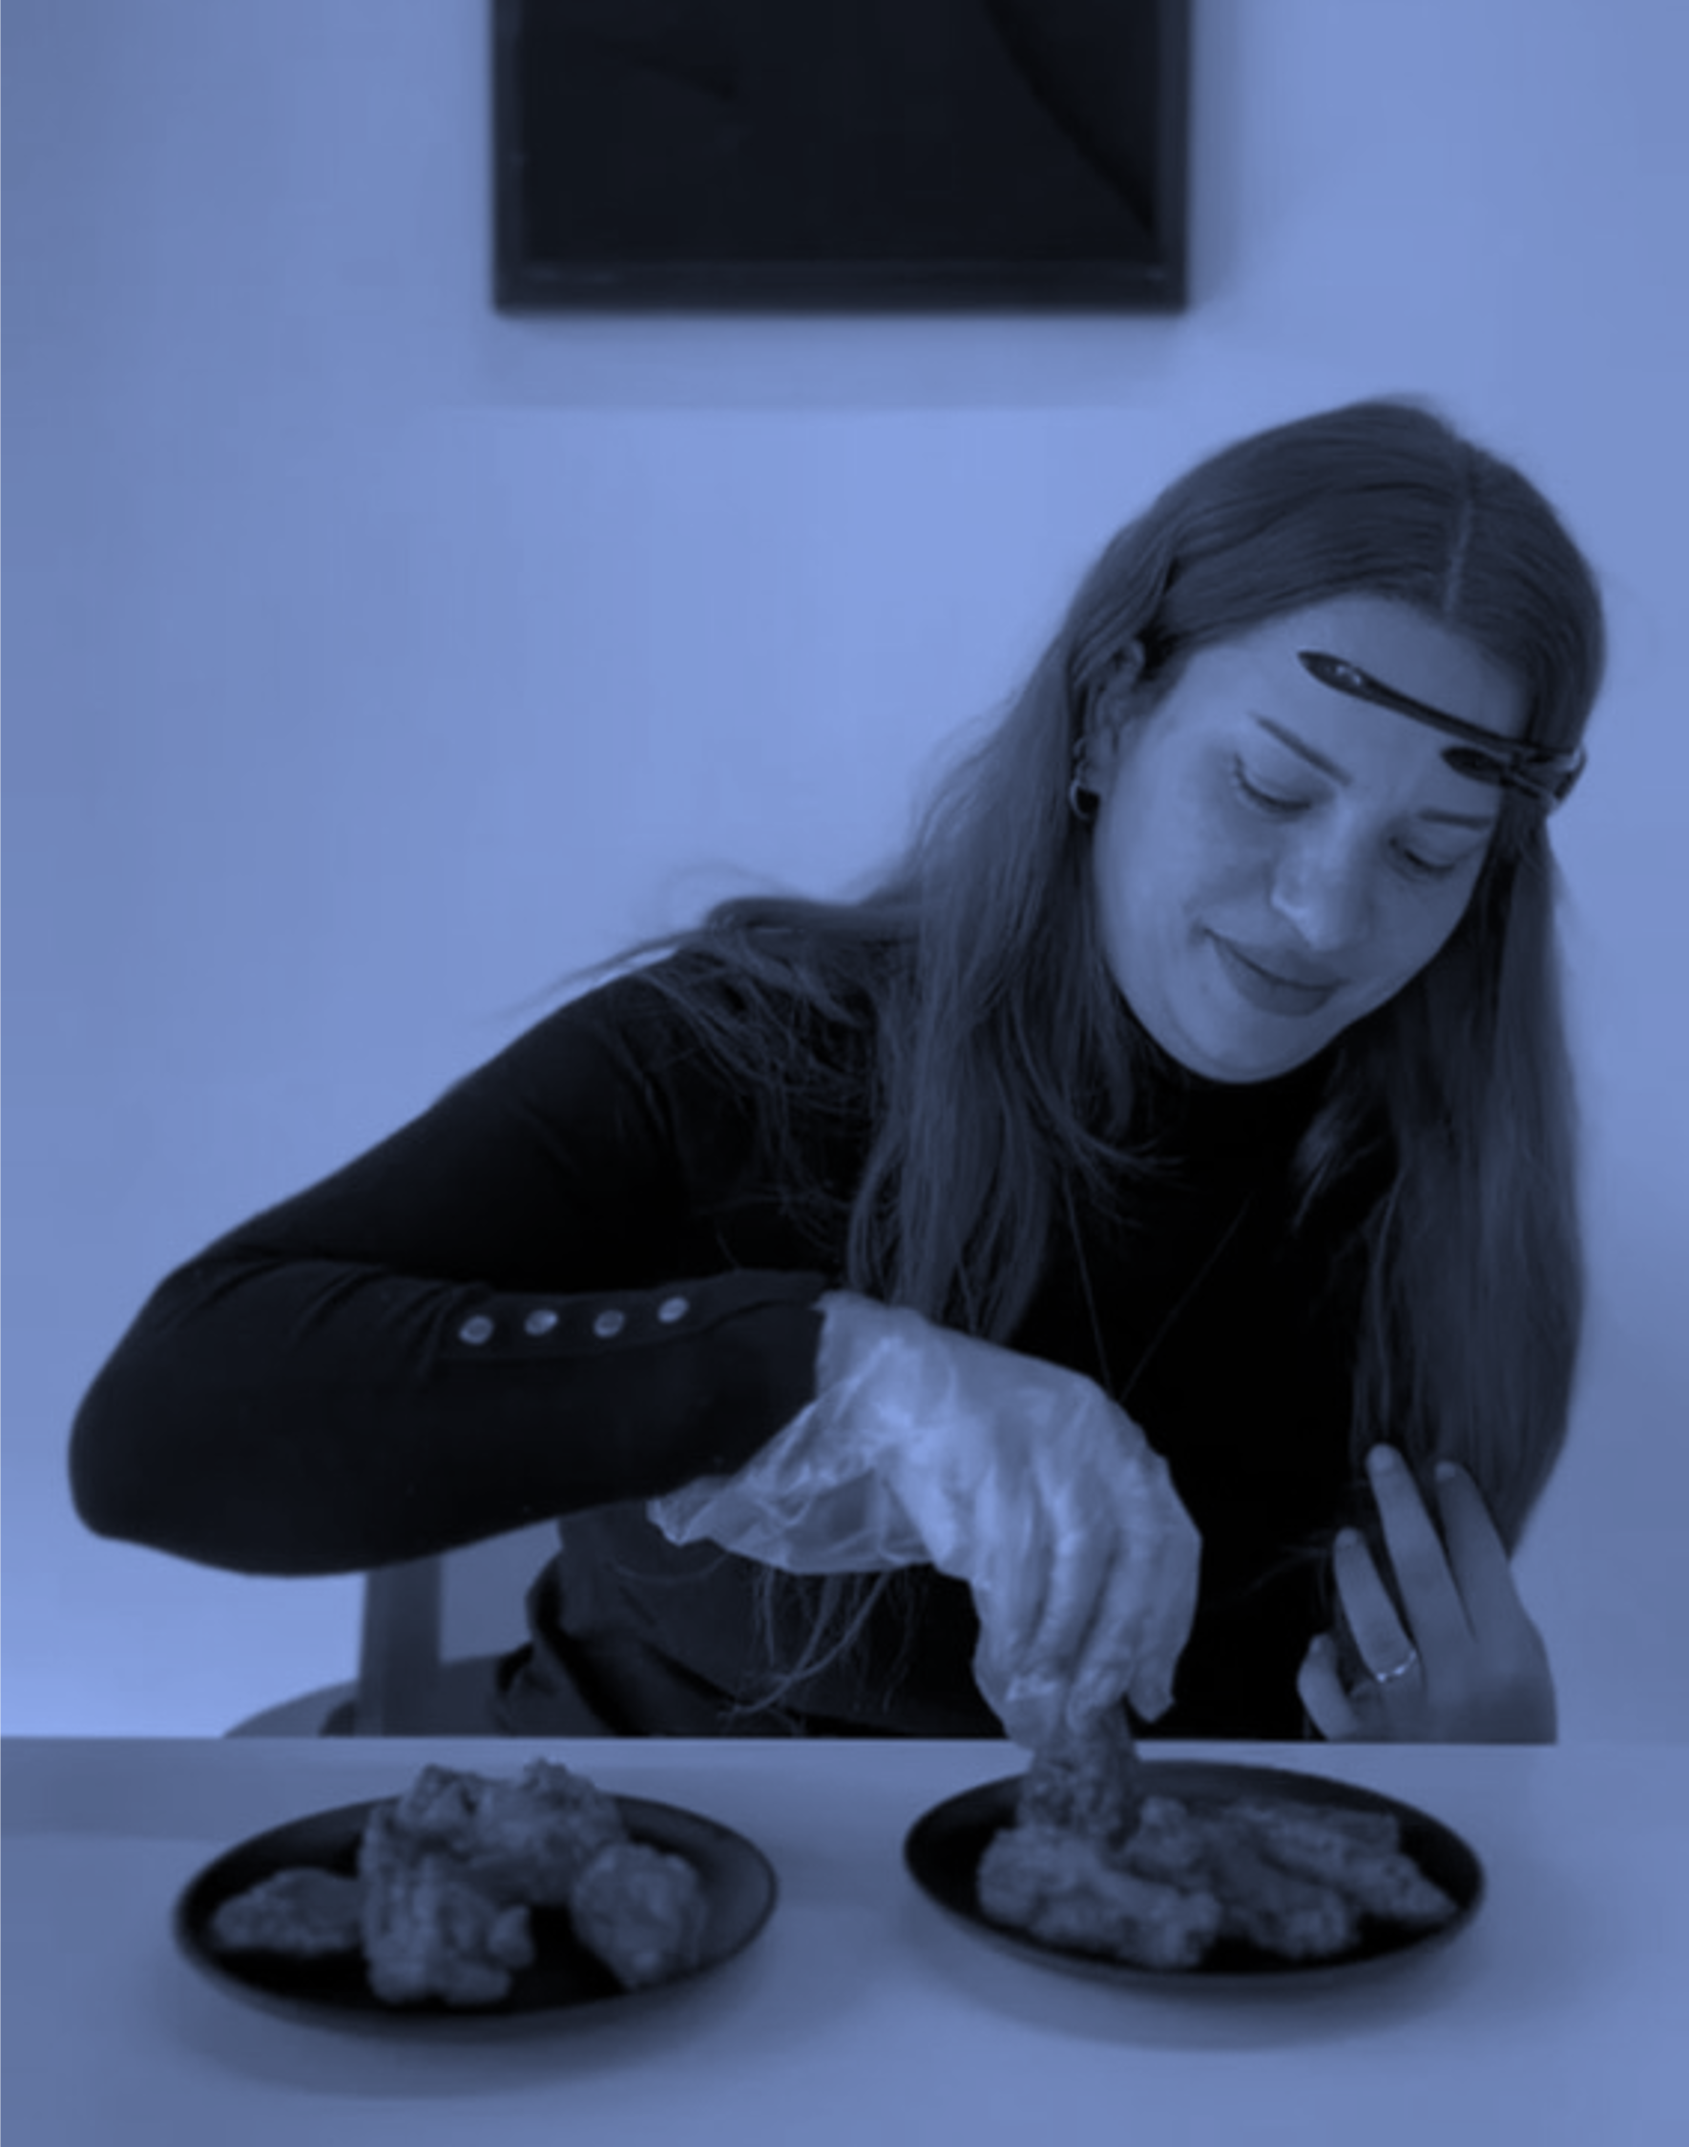


STANDING OUT IN COMPETITIVE MARKETS
WHAT’S HOLDING YOU BACK
You think your product is great, but do your customers feel the same?
HOW WE SOLVE IT
Blind taste testing powered by neuromerics tells the full story.
We measure emotional reactions as participants experience your product without branding or influence. This uncovers authentic responses to taste, texture, packaging, and more; offering a clear picture of perceived quality and emotional impact.
Whether launching a new product or testing variations, this method ensures your product not only tastes good but connects emotionally with your audience.

Slide 22

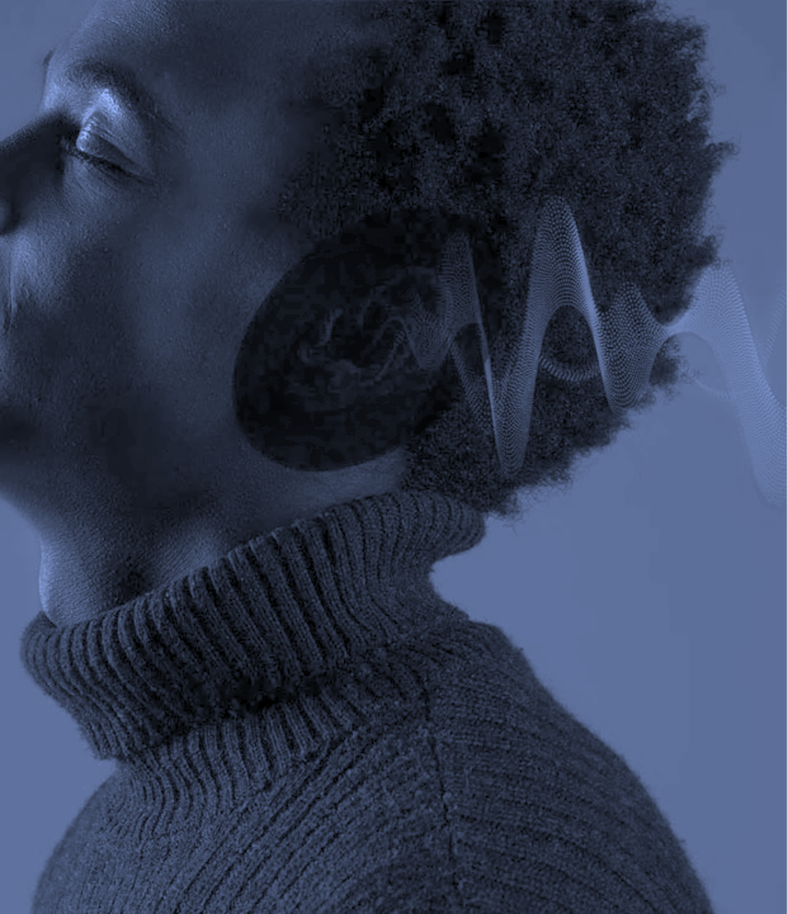


CRAFTING A MEMORABLE SONIC IDENTITY
WHAT’S HOLDING YOU BACK
Your brand sounds generic or inconsistent, and it’s not leaving a lasting impression.
HOW WE SOLVE IT
Sound triggers memory faster than visuals. We use EEG and GSR to measure emotional and cognitive reactions to music, voiceovers, jingles, and sonic logos; identifying the sounds that create emotional resonance, recognition, and brand alignment.
But it doesn’t stop there.
Sonic branding is part of a multisensory ecosystem. When integrated with visuals, language, and motion, it becomes a consistent sensory thread across digital and physical touchpoints; enhancing brand recall, emotional connection, and sensory identity in every interaction.

Slide 23

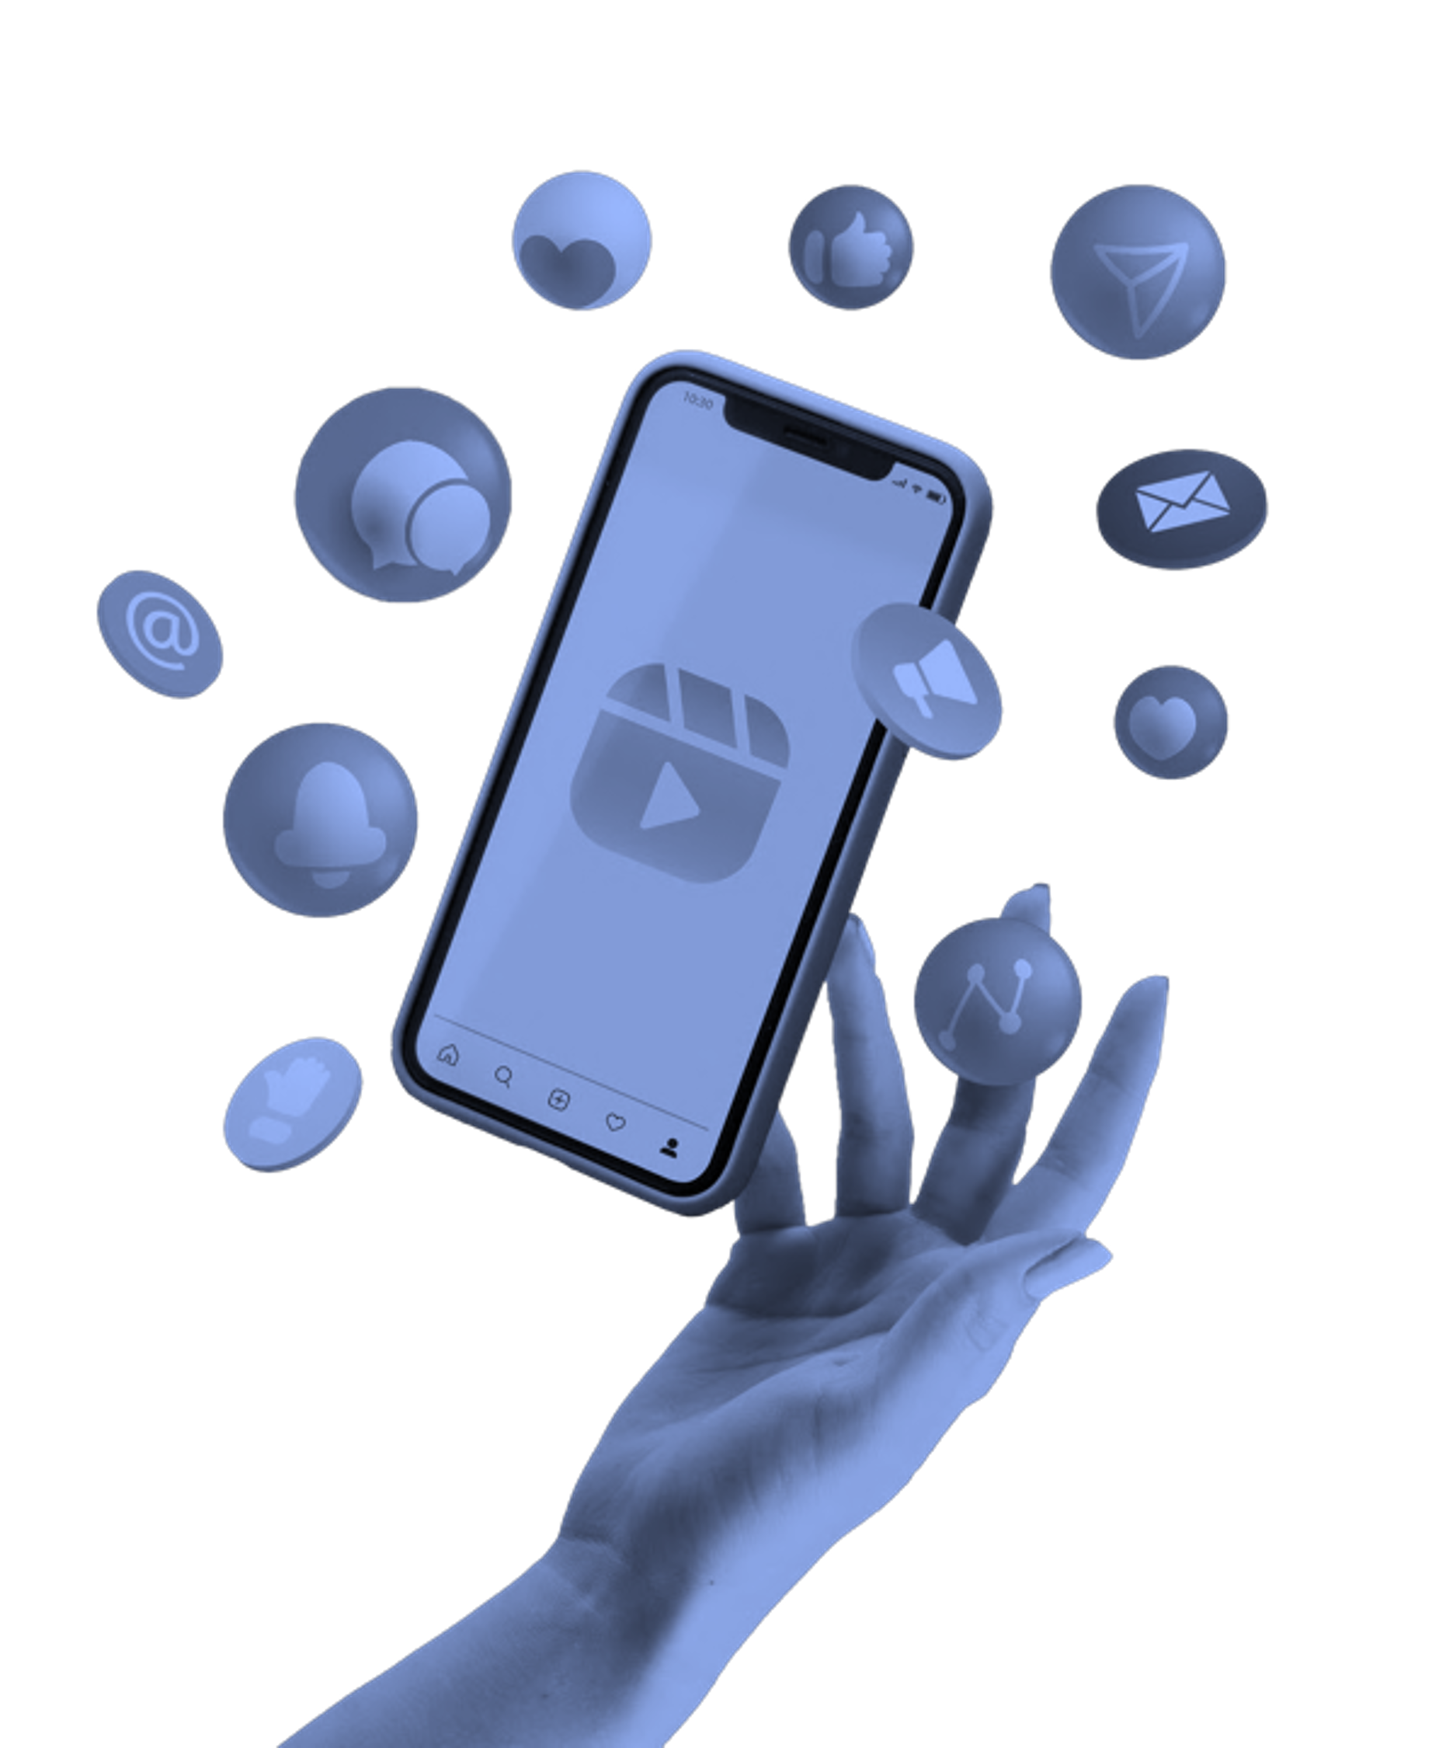


PERSONALIZING DIGITAL EXPERIENCES
WHAT’S HOLDING YOU BACK
You have data but don’t know how to translate it into truly personalized engagement.
HOW WE SOLVE IT
We uncover the subconscious behaviors behind clicks, scrolls, and bounces.
By integrating AI-based eye-tracking, EEG, and
behavioral testing, we analyze how users respond to digital interfaces, what they focus on, what they ignore, and how they emotionally react to different content types.
This enables us to build data-informed personalization strategies that adapt in real- time, delivering the right message, at the right time, in the way users prefer to receive it.

Slide 24



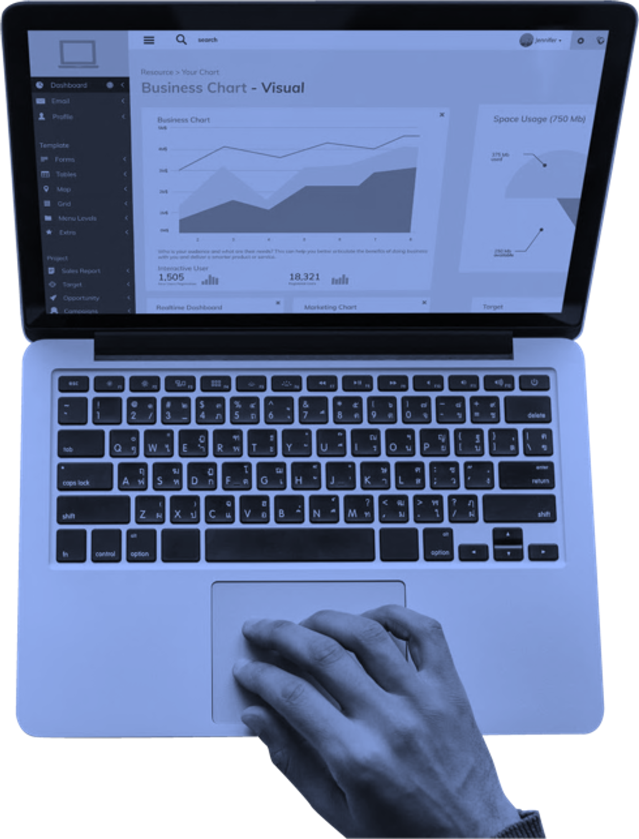


OPTIMIZING CONVERSION RATES ON WEBSITES
WHAT’S HOLDING YOU BACK
You’re attracting traffic but not converting users into customers.
HOW WE SOLVE IT
We apply neuromarketing tools to decode user friction.
Using AI eye-tracking, EEG, and GSR, we evaluate what’s capturing attention and what’s confusing or frustrating. We track emotional responses during key conversion moments, like form submissions, purchases, or call-to-action interactions.
This allows us to refine content, layout, and flow to reduce hesitation and cognitive load; boosting clarity, trust, and conversions across the board.

Slide 25


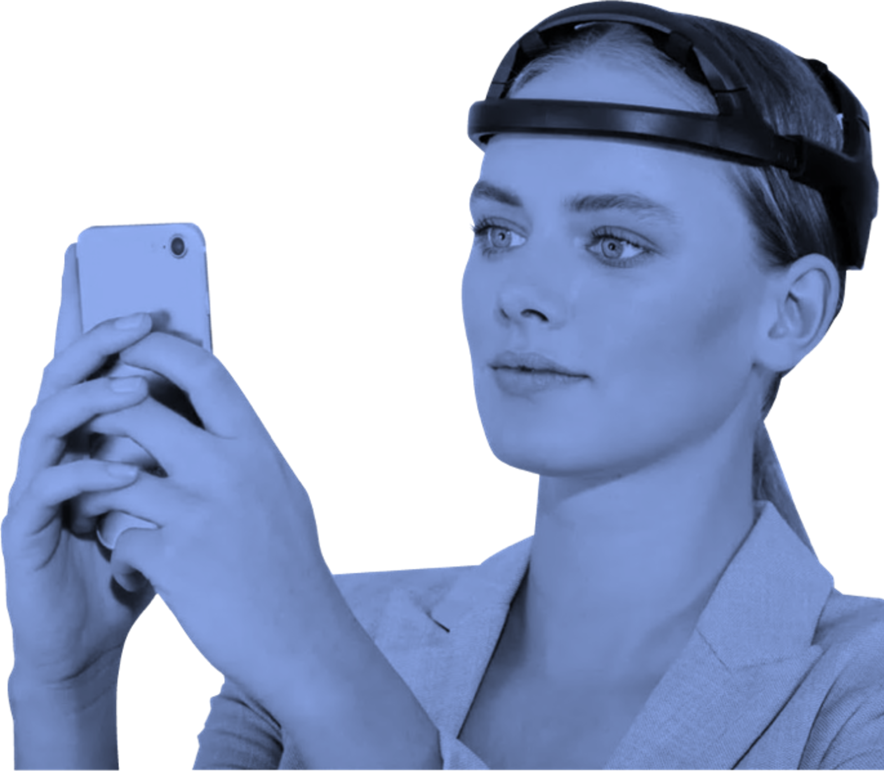


ENHANCING APP USER RETENTION AND ENGAGEMENT
WHAT’S HOLDING YOU BACK
Users download your app, but don’t stay or engage regularly.
HOW WE SOLVE IT
Retention isn’t just about functionality; it’s about emotional relevance.
We measure cognitive load and emotional response through EEG and GSR as users navigate your app. Combined with eye- tracking, we pinpoint areas of friction, disinterest, or delight, mapping emotional journeys across usage paths.
This helps refine onboarding flows, UI/UX design, and content triggers to create experiences that are intuitive, rewarding, and habit-forming.

Slide 26
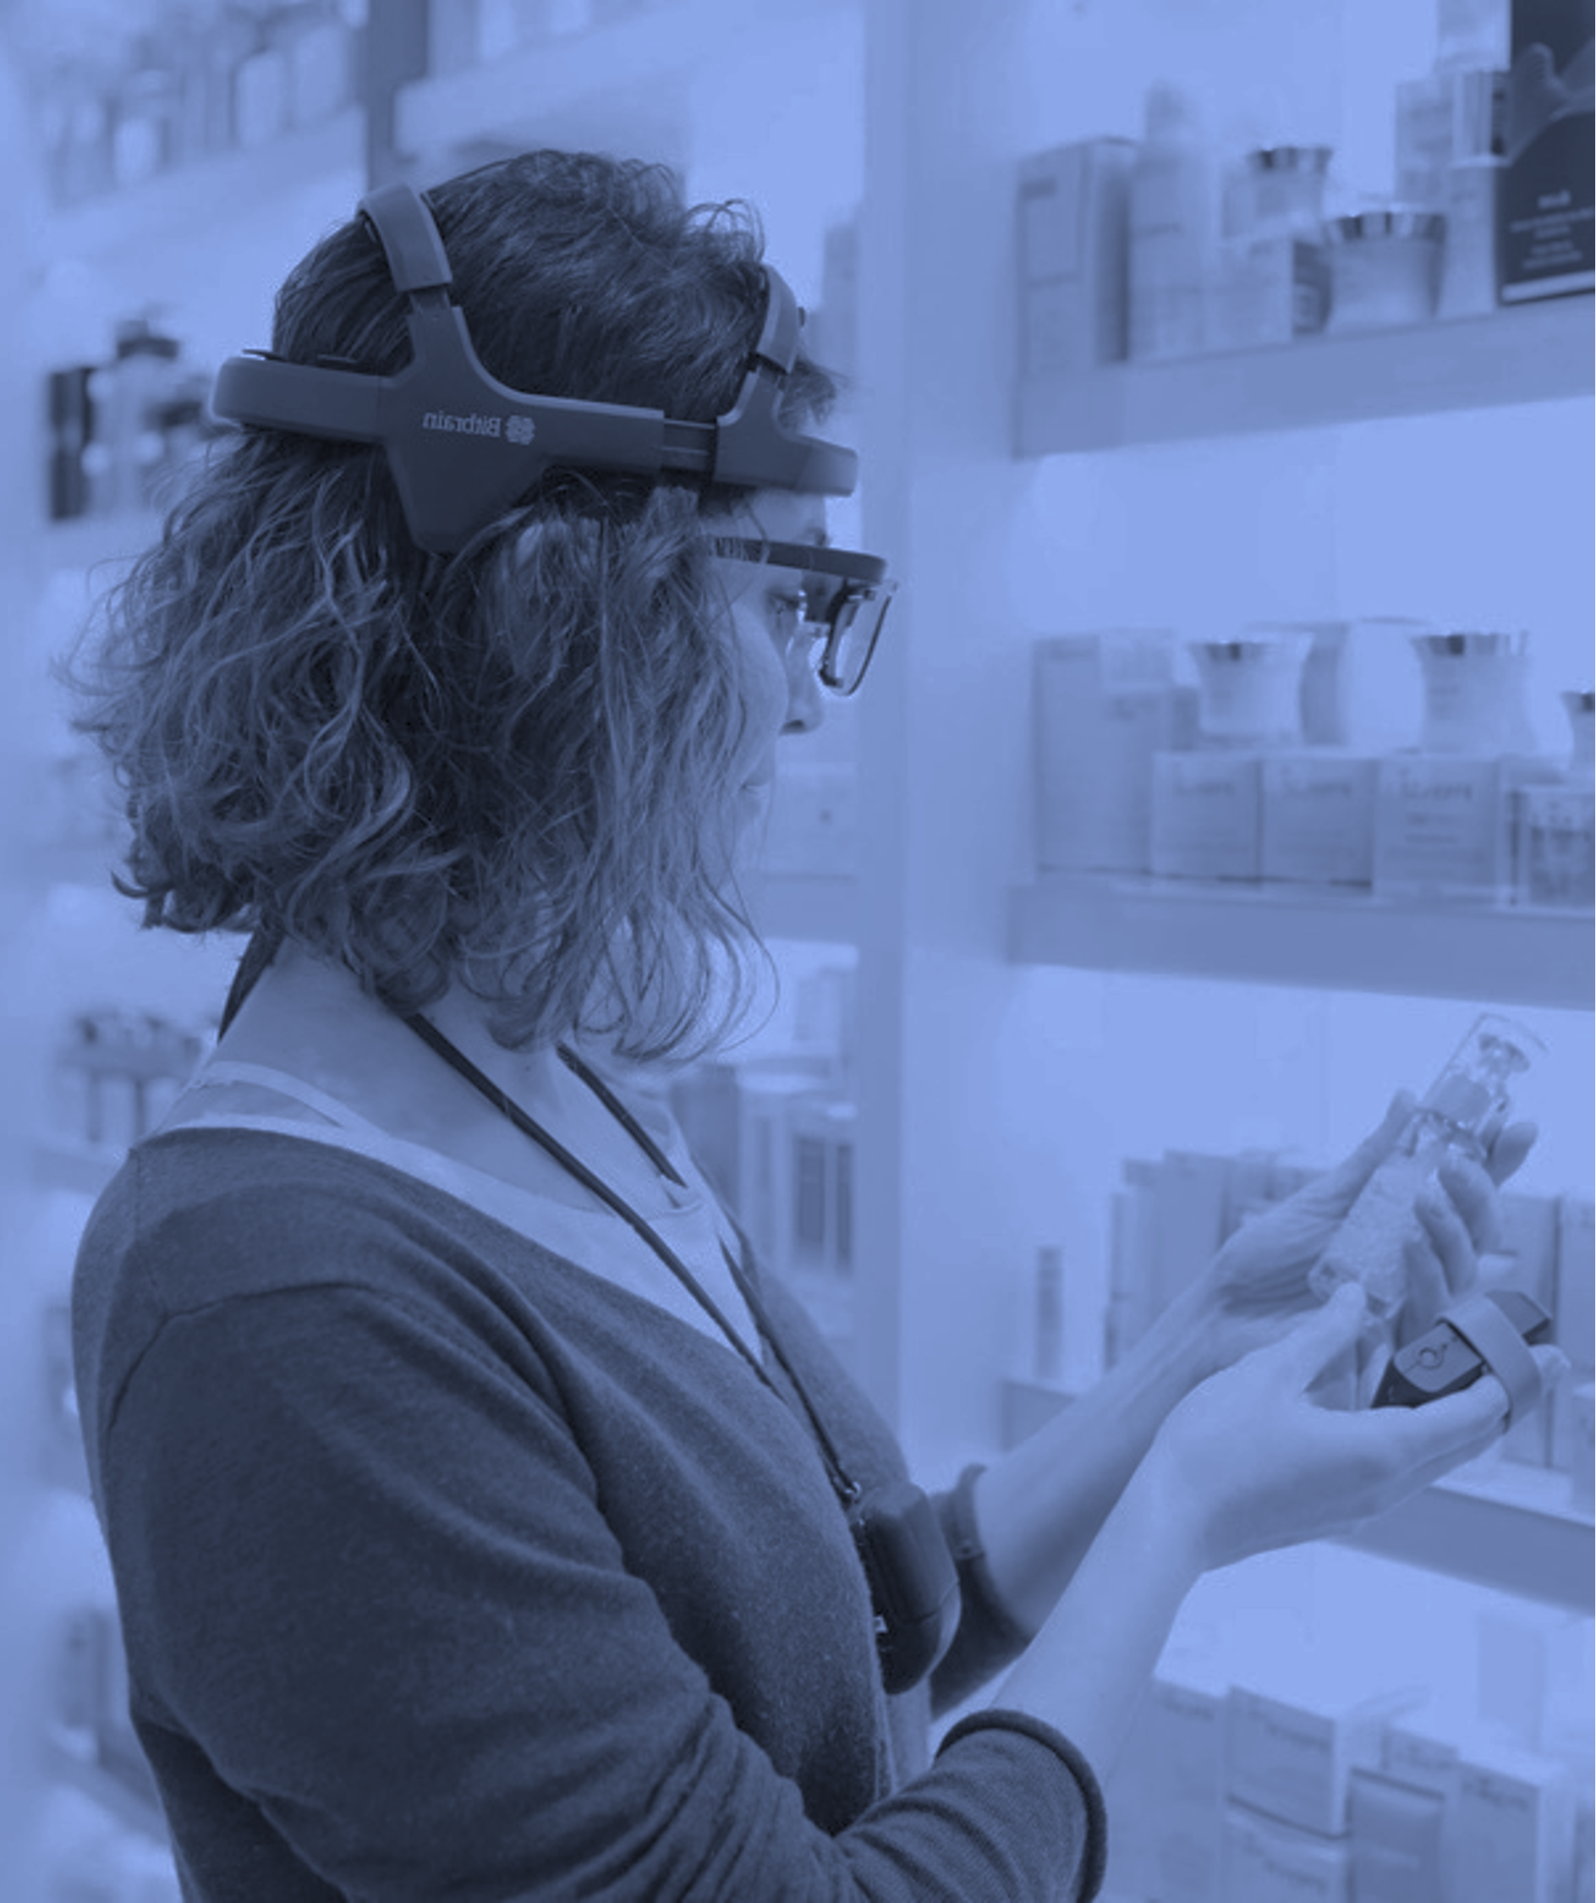


ENHANCING IN-STORE CUSTOMER ENGAGEMENT
WHAT’S HOLDING YOU BACK
You can’t tell which elements in-store truly influence behavior.
HOW WE SOLVE IT
We bring neuromarketing into the physical environment.
Using our technologies, we capture how customers interact with products, displays, shelves, signage, and environments; revealing where attention goes and how people feel as they explore your space.
This informs store layout, sensory branding, and product placement to optimize flow, engagement, and impulse behavior, maximizing both dwell time and sales.

Slide 27

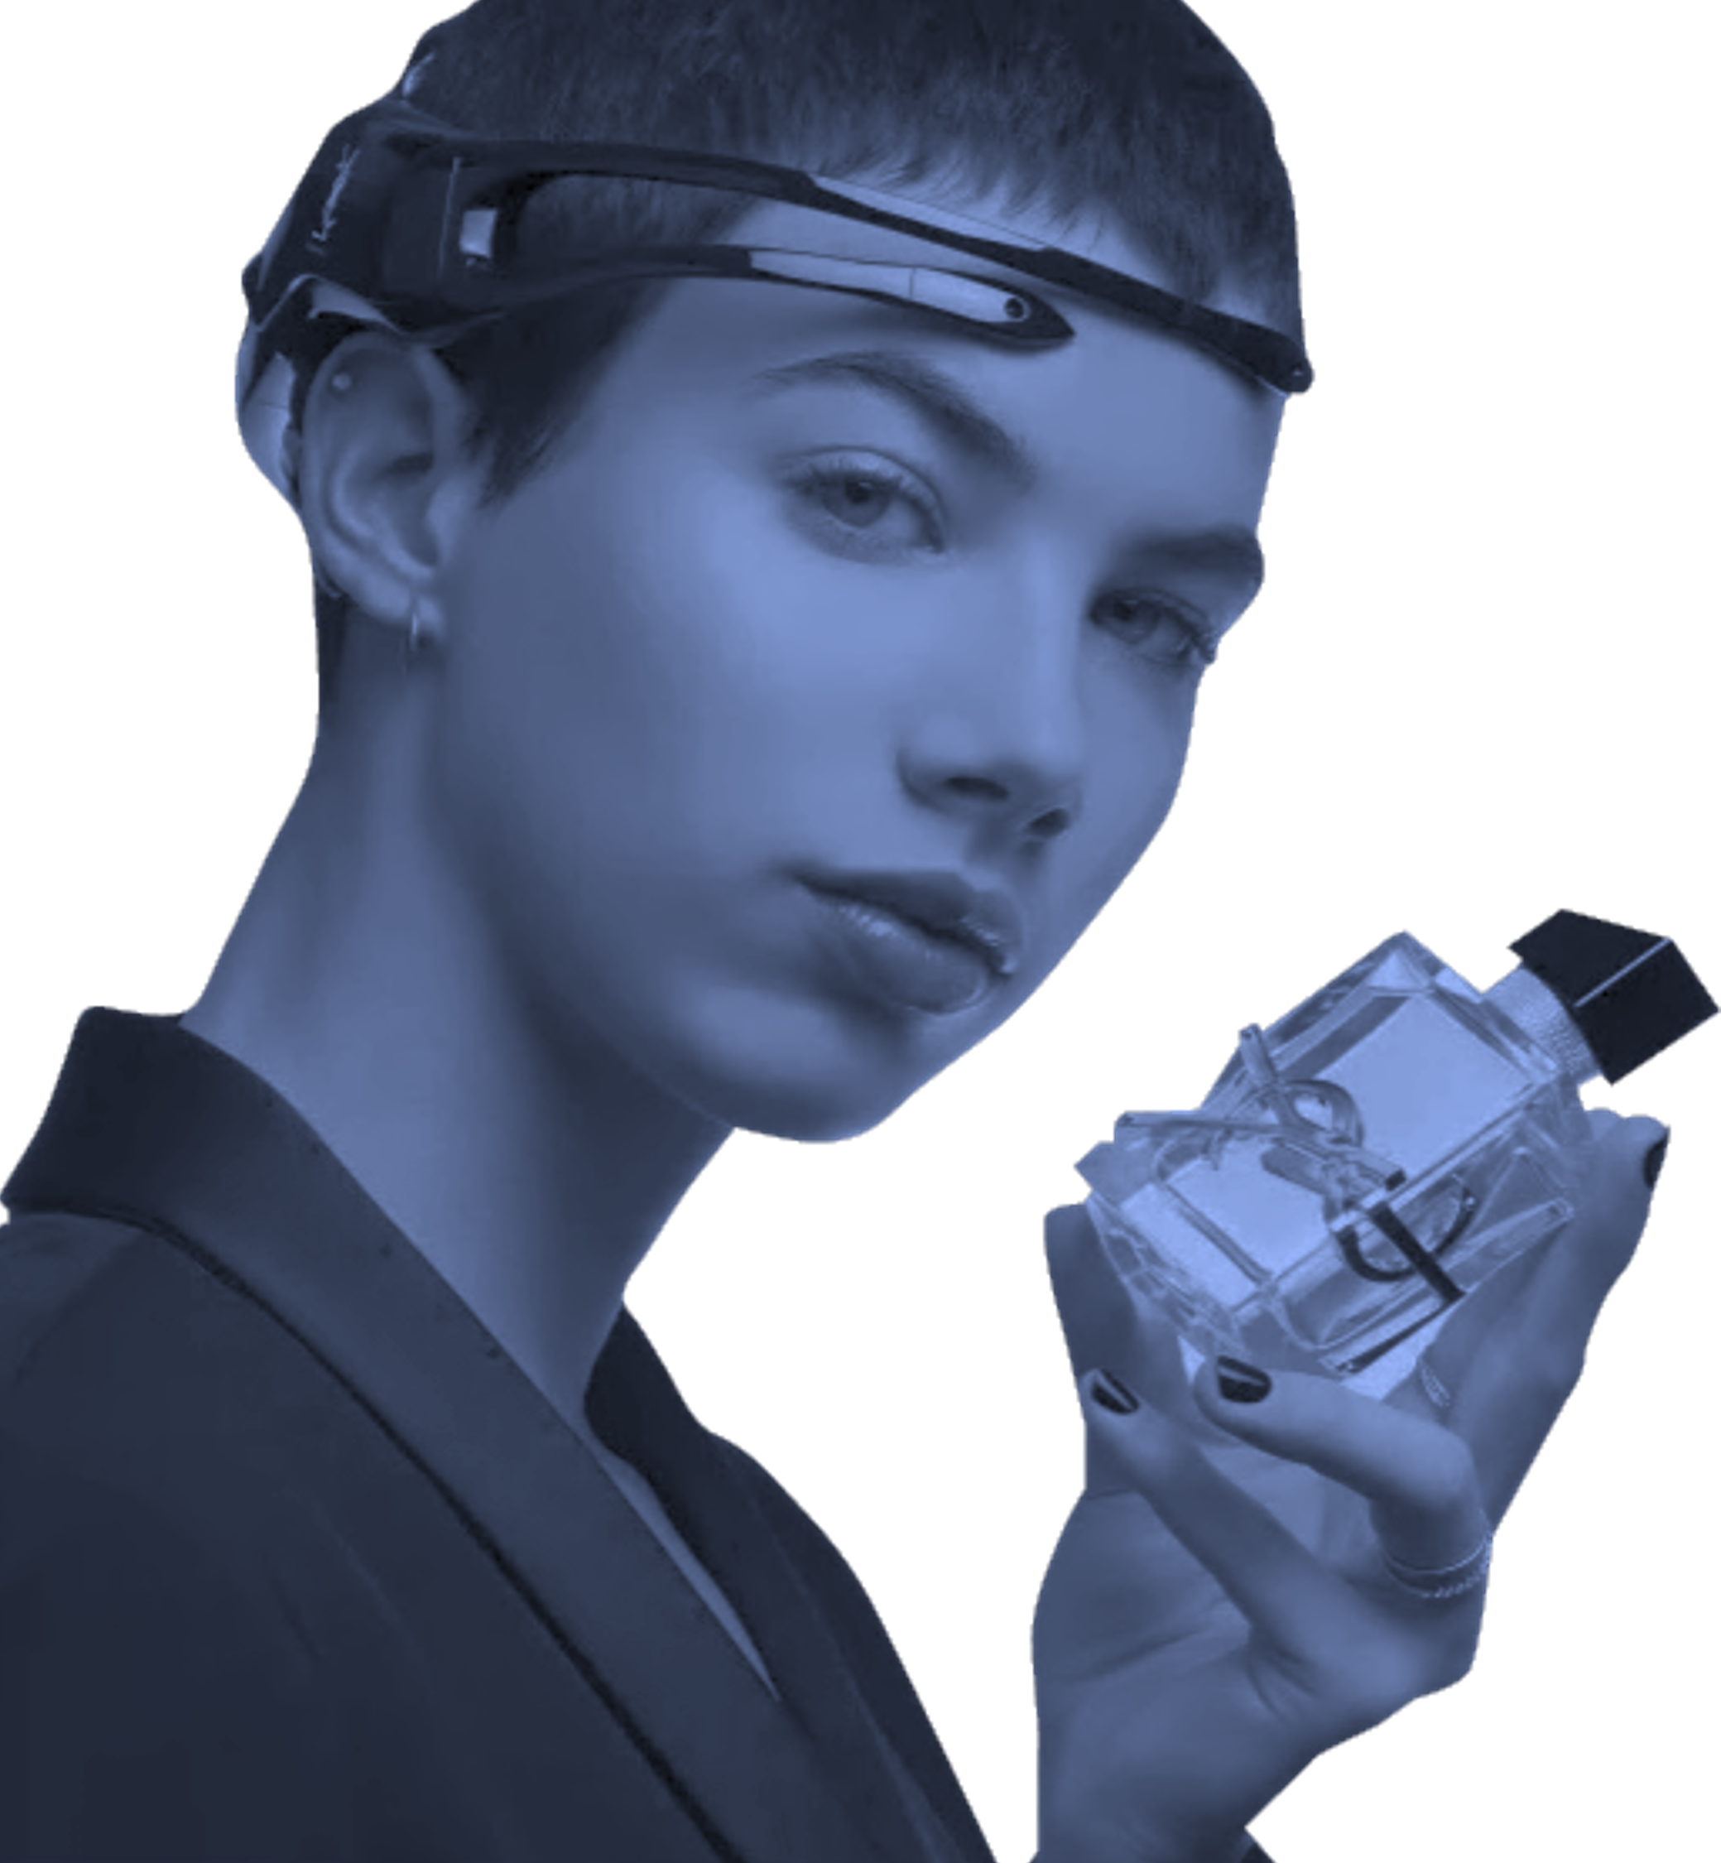



EVALUATING PRODUCT
APPEAL AND EFFECTIVENESS
WHAT’S HOLDING YOU BACK
Your product is ready, but you’re unsure if it creates the right impact.
HOW WE SOLVE IT
We go beyond surveys to capture subconscious perception.
From blind taste tests and product demos to unboxing experiences, we use EEG and GSR
to measure excitement, satisfaction, and
emotional friction, before and after interaction.
By identifying sensory triggers and emotional outcomes, we fine-tune product features, packaging, and messaging; ensuring that what you launch is what people truly want.

Slide 28

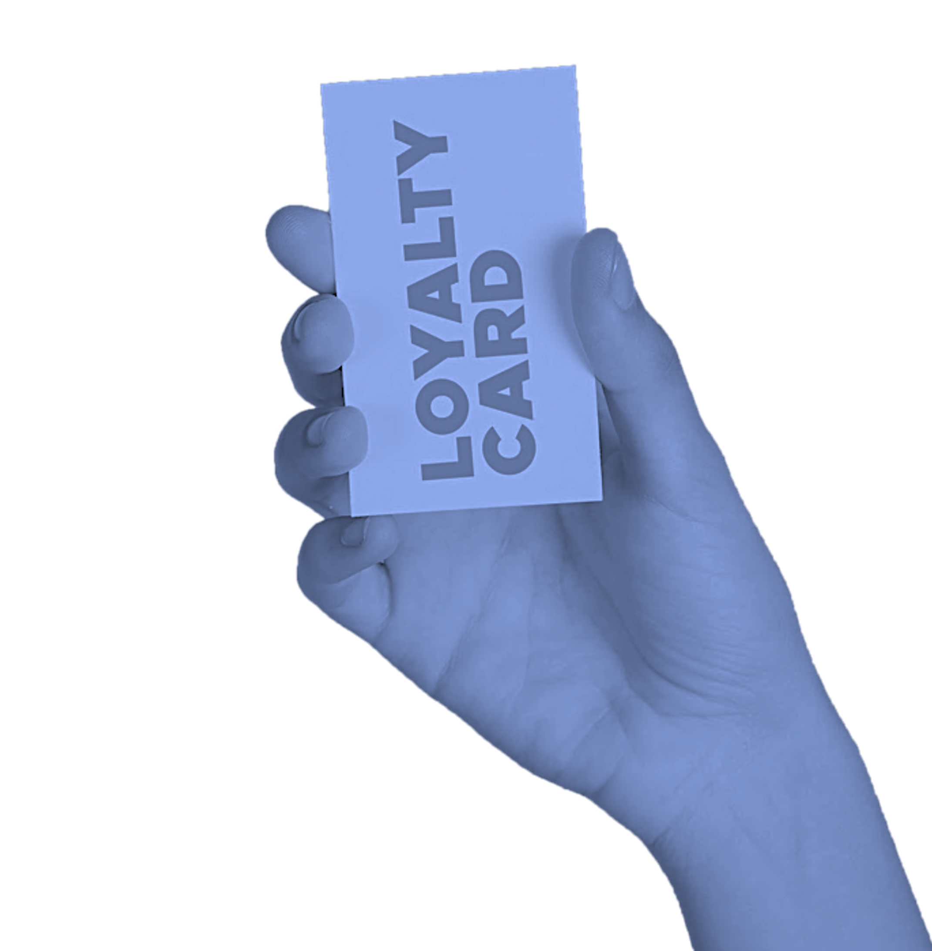


INCREASING CUSTOMER LOYALTY & PROGRAM IMPACT
WHAT’S HOLDING YOU BACK
Your loyalty program exists but participation and emotional connection are low.
HOW WE SOLVE IT
Loyalty is emotional first, transactional second.
We analyze emotional motivators using EEG and GSR to understand what drives repeat engagement and what turns people away. We test the emotional impact of rewards, program communication, and gamification mechanics.
Importantly, we ground loyalty strategy in behavioral science; tapping into reward systems, habit loops, and intrinsic motivation.
This ensures your program isn’t just remembered, it becomes part of your customer’s rhythm, building loyalty that’s not only earned but felt.

Slide 29

Case studies

Slide 30

Neuro blind taste test
Lebanon’s most iconic fast-food chain wanted to validate one essential truth:
Does the product still win when the brand is stripped
away?

Slide 31
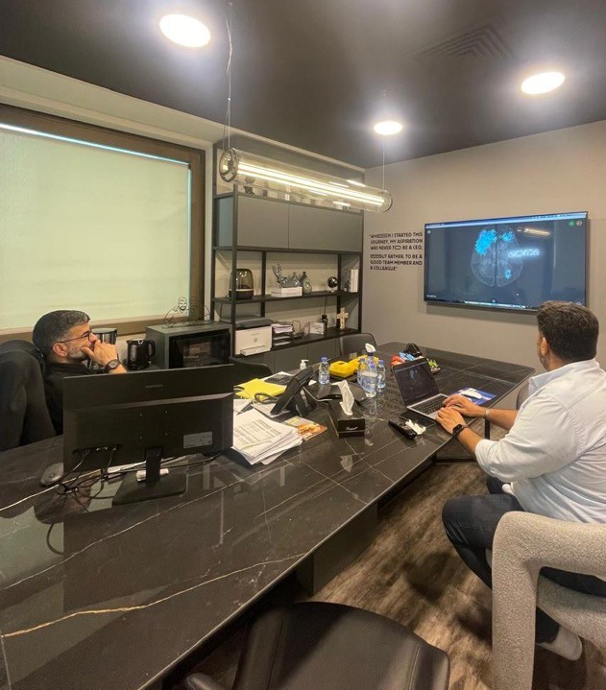
At Lime Lab, we protect brand futures. Clarity isn’t always comfortable, but it always pays off.

Slide 32
LIME LAB METHOD
We conducted a blind taste test comparing Malak Al Tawouk’s signature sandwich with those of key competitors. The process was entirely triple-blind; neither testers, facilitators, nor analysts knew which brand was behind each sample. This ensured pure sensory judgment, untainted by marketing or loyalty bias.
SCIENTIFIC INSIGHT
Surprisingly, a competitor’s sandwich was consistently chosen as the favorite across
test groups. While Malak Al Tawouk ranked high, it did not lead in blind preference. This result was a critical insight: brand equity was strong, but product experience needed evolution to match perception.
STRATEGIC OUTCOME
Rather than relying on legacy strength, Malak Al Tawouk gained clear, data-backed
direction for R&D and product innovation. Lime Lab provided tailored recommendations on flavor enhancement, texture optimization, and experience design, all aimed at ensuring the product could match, and exceed, the emotional power of the brand.

Slide 33

Testing the Crave Factor
Cheese on Top launched the Open Wings Experience to boost in-store traffic and customer excitement.

Slide 34
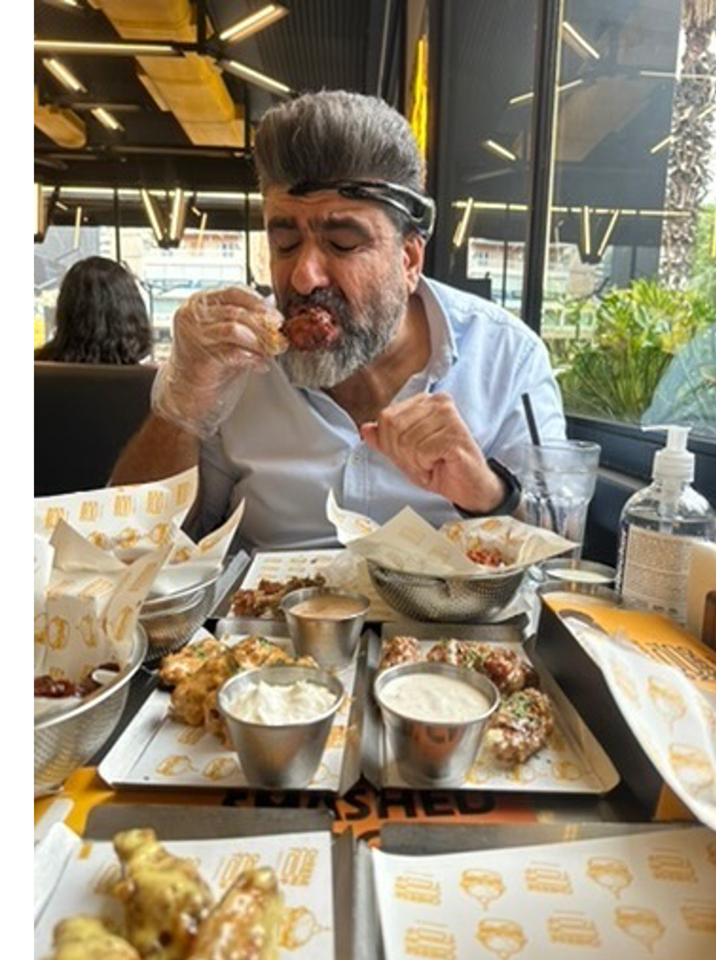
We don’t just test products. We decode the full sensory and emotional journey, so brands can serve not just food, but unforgettable moments.

Slide 35
LIME LAB METHOD
We ran an on-site evaluation combining taste satisfaction surveys with behavioral observation, tracking emotional engagement and flow across the dining experience.
SCIENTIFIC INSIGHT
Wings scored high on taste and value. But we detected emotional drop-offs
during waiting periods and mid-meal; signaling gaps in pacing and engagement.
STRATEGIC OUTCOME
We delivered clear recommendations to optimize service flow, sustain
emotional peaks, and expand testing across all audience segments. The result: a more immersive, craveable experience.

Slide 36

Designing Experiences
with the Brain in Mind
Exit to Nature wanted to optimize both the customer journey and the pilot experience, using emotional and cognitive data.

Slide 37
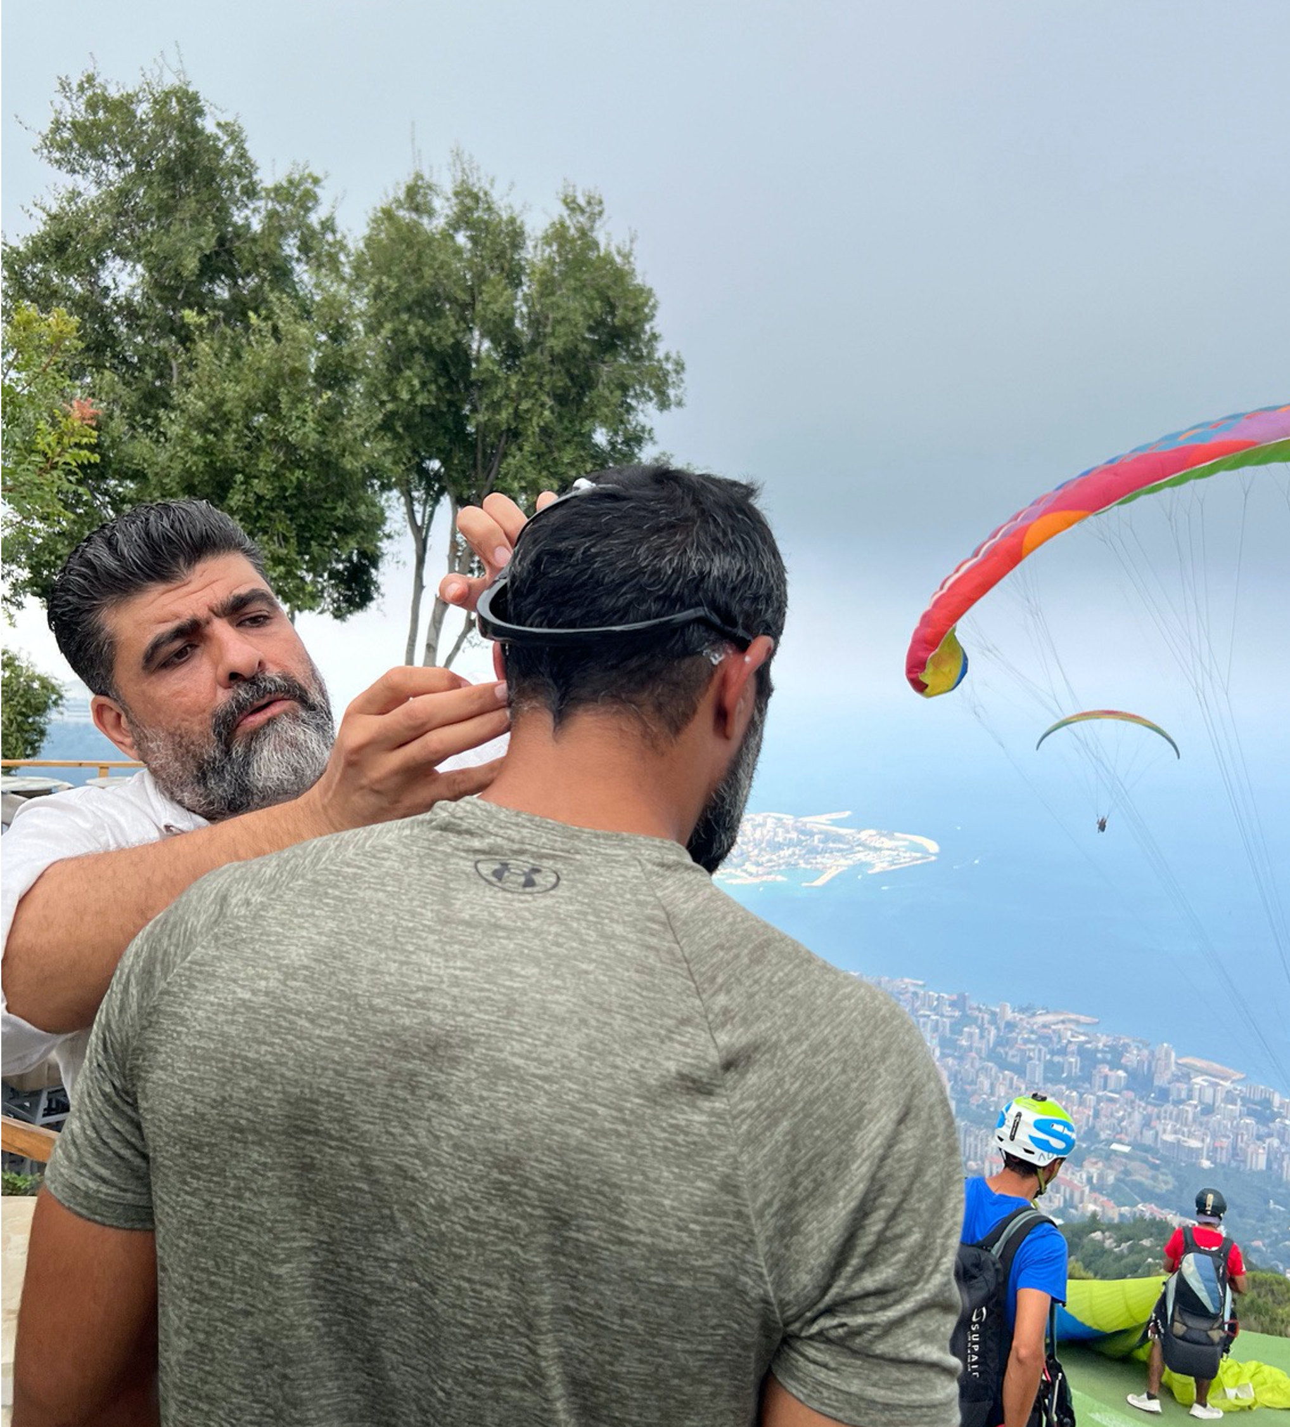
Emotions are the journey. We just map it.

Slide 38
LIME LAB METHOD
We equipped customers and paragliding pilots with EEG during real flights, capturing brain activity across the full experience: preparation, takeoff, flight, and landing.
SCIENTIFIC INSIGHT
We detected a peak of emotional arousal at takeoff, followed by a shift
into calm and clarity mid-air. Pilots showed similar patterns, offering insight into their mental load and flow state. The data revealed key emotional touch points and stress moments in both journeys.
STRATEGIC OUTCOME
Lime Lab delivered clear recommendations to optimize service design, staff
flow, and emotional pacing. The result: a more centered, memorable, and efficient experience for customers and staff alike.

Slide 39
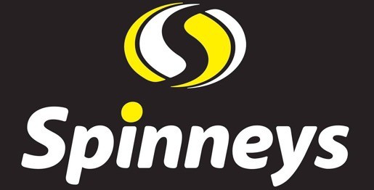
NEURO EVALUATION OF
IN-STORE COMMUNICATION
Spinneys wanted to assess how intuitive their store layout truly is, from a shopper’s point of view.

Slide 40
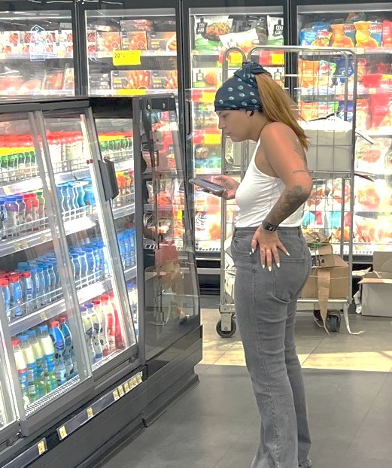
The brain hates friction. Your store layout shouldn’t create it.

Slide 41
LIME LAB METHOD
Two participants were given the same shopping list and asked to find all items unaided. We timed the journey and analyzed their navigation patterns.
SCIENTIFIC INSIGHT
One completed the task in 14 minutes, the other in 25 , revealing
inconsistencies in how shoppers mentally map the space. Key friction points were found in signage, product grouping, and navigation clarity..
STRATEGIC OUTCOME
Lime Lab delivered concrete recommendations to improve wayfinding, shelf logic, and layout flow — making the experience faster, smoother, and more
intuitive.

Slide 42
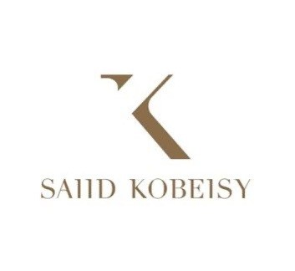
Employee Performance
and Well-being
Saiid Kobeisy, wanted to better understand the emotional health of its internal teams; to maintain performance and reduce internal friction.

Slide 43
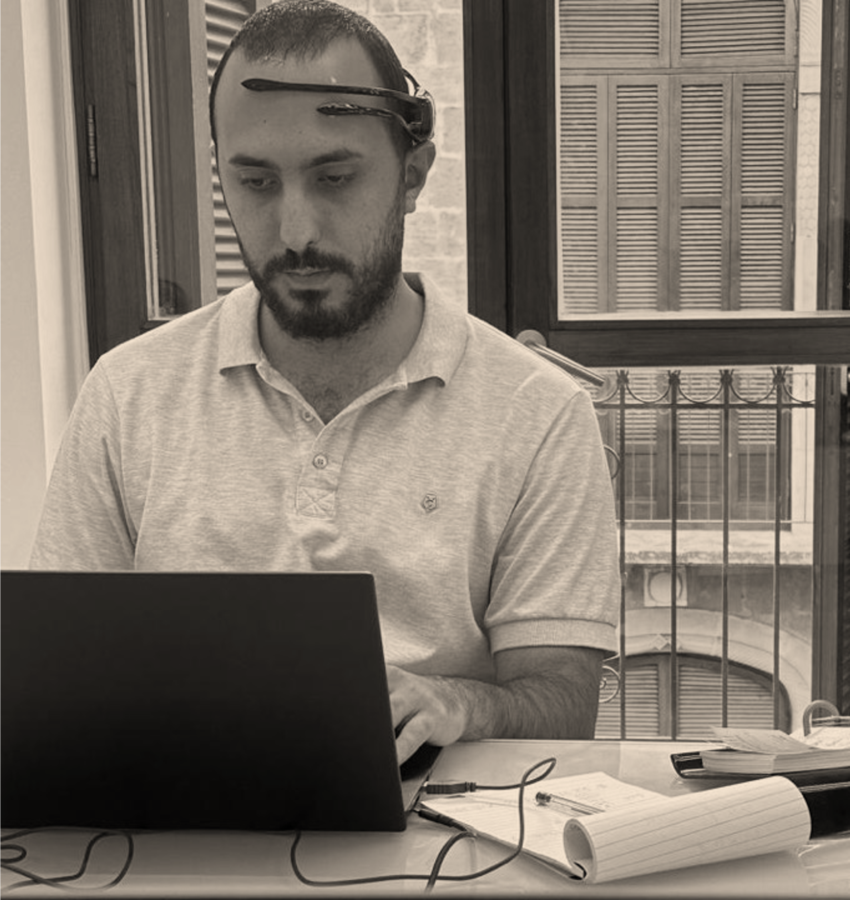
Brands shine brighter when their teams feel seen.

Slide 44
LIME LAB METHOD
Lime Lab conducted an employee satisfaction study, combining structured surveys and in-depth emotional mapping across departments.
SCIENTIFIC INSIGHT
The study revealed high engagement in some teams, but also signs of
emotional fatigue, role ambiguity, and communication gaps in others, particularly in high-intensity functions.
STRATEGIC OUTCOME
We delivered tailored recommendations to improve internal communication,
clarify team expectations, and support emotional resilience.
The result: a roadmap for building a more aligned, supported, and high- performing team.

Slide 45
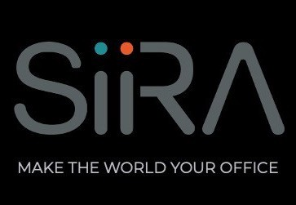
NEURO-EVALUATION OF SIIRA:
APP ONBOARDING PROCESS
Evaluate and improve the emotional and cognitive experience during the onboarding journey; the critical first touchpoint for new users.

Slide 46
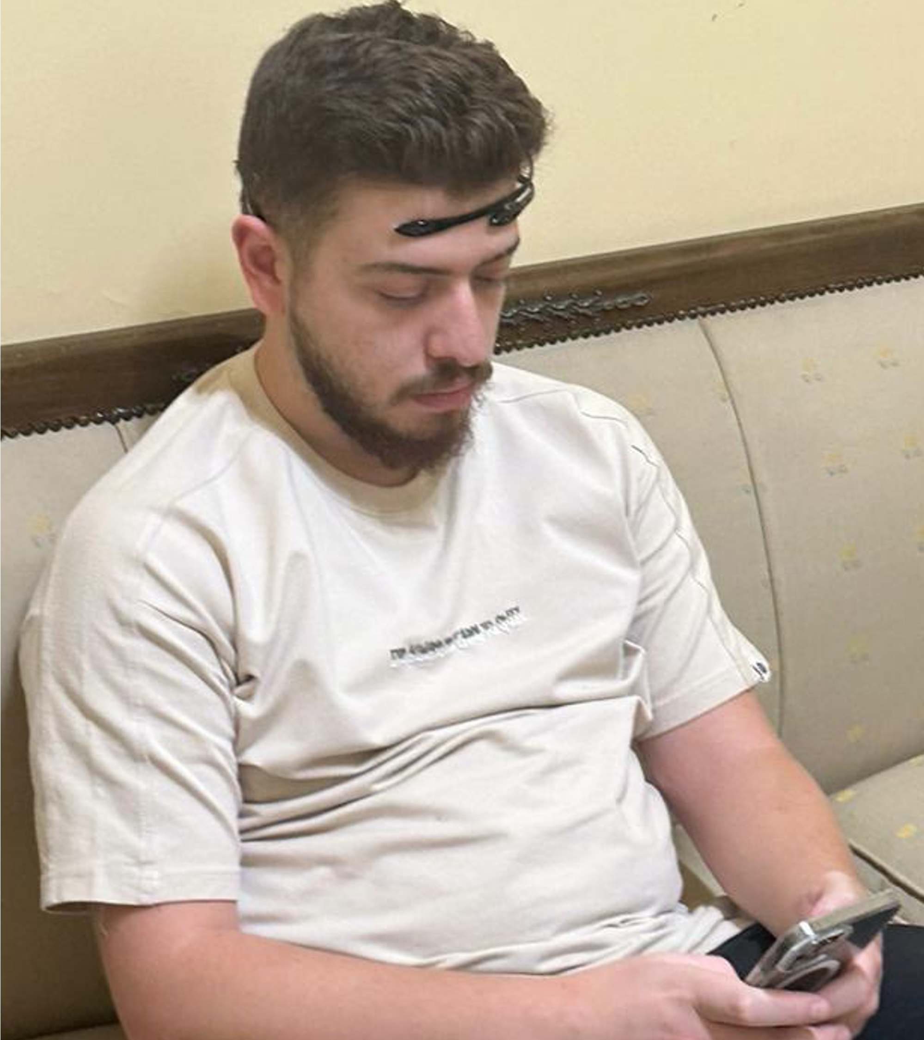
You built the algorithm.
We mapped
the emotion.

Slide 47
LIME LAB METHOD
Lime Lab studied the user onboarding flow, analyzing both usability patterns and emotional responses across key decision points.
SCIENTIFIC INSIGHT
Users showed signs of confusion and hesitation, particularly around data
entry and purpose clarity. There was an emotional gap between the AI- powered brand positioning and the actual onboarding tone.
STRATEGIC OUTCOME
We delivered targeted recommendations to improve content flow, tone, and
interaction logic; reducing early friction, building user trust, and aligning the experience with SIIRA’s intelligent, human-centered brand.

Slide 48

THA_{Y}NK_{OU}
growth@sparkitt.info info@limebuzz.marketing
Jordan: 0789719248 / 0786812418
Lebanon: +961 71 985 748 / +961 81 393 496

